Slide 1
1. AI-generated Financial Analyst Reports
Develop a system to generate high-quality analyst reports for stocks to support investment decision-making
Focus on HK or US stocks
Potential data sources
Financial statement and market data from WRDS through the university library
Yahoo Finance
Seeking Alpha
Firm filings

Slide 2
2. Competitive Intelligence for Master Programs
Develop a system to collect, structure, and analyze public data on business school master programs to support strategic decisions by deans and program directors
Focus on non-MBA master programs (i.e., TPG programs)
Use publicly available information only (program websites, brochures, rankings, news, etc.).

Slide 3
3. Agent‑Based Intelligent Travel Planner
Develop an AI agent that creates personalized travel plans for individuals or groups by integrating maps, POI data, and social media content to support travel decision‑making
Focus on trip planning for a city or region (e.g., 2–5 day itinerary)
Use free or public data sources (e.g., Gaode Maps API, RedNote).
Travel scenarios may include leisure, family, or theme‑based trips.

Slide 4
Introduction to LLM
Hailiang Chen
HKU Business School

Slide 5
Course Information
Instructor:
Prof. Hailiang CHEN, chen19@hku.hk
Consultation Hours:
Time: TBD
Office: Room 840, KK Leung Building, Main Campus
Teaching Assistant:
Miss Ruoxin Li, ruoxinli0112@connect.hku.hk: assignment grading
Mr. Shuang Li, ls499858@hku.hk: attendance

Slide 6

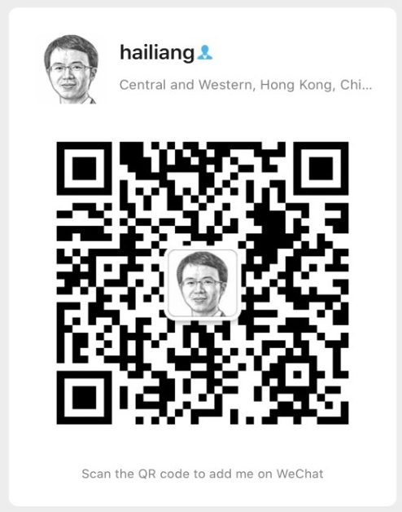
Contact Me
WhatsApp
WeChat
Email: chen19@hku.hk
Mobile/WhatsApp: 56338553
WeChat: better4us
LinkedIn: https://www.linkedin.com/in/hailiang-chen/

Slide 7
Course Information
Assessment
In-class and Online Participation: 20%
Individual Assignment: 30%
Group Project: 50%
Attendance follows faculty policy; students must attend at least 70% of lectures to pass.
Group Project assessment is also individual-based, i.e., different members in the same group can get very different scores.

Slide 8
Utilisation of AI Tools
The use of AI tools is permitted and highly recommended.
Nevertheless, any use of AI must be documented for both individual assignments and group project submissions.
Adhere to the provided guidelines to properly disclose AI involvement.

Slide 9
Course Information
Participation: 20%
In-class Participation: 10%
Attending more lectures would be appreciated
In-class Participation Self-Report Google Form: https://forms.gle/nwhNfZ8PosZZYwBB9
Ask/answer questions; make comments; make presentations
Online participation through Moodle and other designated platforms: 10%
Take-home assignments on Moodle
In-class presentation submissions on Moodle
Course forum
“Novel” contribution to discussions: no duplicate content
Asking for help or offering help on technical issues

Slide 10
In-class Individual Presentation
Share anything interesting or useful about LLM
Upload presentation slides (.ppt or .pptx) on Moodle (submissions accepted continuously; earlier submissions are encouraged)
Earn credits for online participation
Qualify for the limited opportunity to present
Presenters for upcoming lectures will be informed several days in advance
Presentations are limited to a maximum of 5 minutes each
Presentations typically begin after the first break

Slide 11
Sample Ideas for Individual Presentations
Present solutions for a take-home ungraded assignment
Recent advancements in large language models and AI agents
Personal approach to applying LLMs for a particular challenge
Innovative ways to utilise LLMs
Constraints and challenges of LLMs
Practical implementations of LLMs in real life
…

Slide 12
Course Information
Individual Assignments: 30%
AI Resume Editor
Function Calling for GitHub Repository Queries
You should complete the assignments by yourself without consulting other students or the TA, i.e., treat it like a take-home and open-book exam

Slide 13
Course Information
Group Project: 50%
Project Proposal (one page): 5%
Data and Program Code: 15%
Project Report (10 pages max): 10%
Group Presentation: 20%
Each group member is encouraged to present
8 members/group
Randomly assigned presentation sequence

Slide 14
Group Project
Group formation on Moodle (Mar 27 Friday)
Find team members by yourselves first if you want
On Mar 28, those who do not find a group by the deadline will be randomly assigned to groups that are not full
Factors to consider
Each team should have an agreement on how to work together
Instead of having one fixed team leader, members can take turns to be the leader

Slide 15
Group Project Ideas
AI-generated Financial Analyst Reports
Competitive Intelligence for Master Programs
Agent‑Based Intelligent Travel Planner

Slide 16
1. AI-generated Financial Analyst Reports
Develop a system to generate high-quality analyst reports for stocks to support investment decision-making
Focus on HK or US stocks
Potential data sources
Financial statement and market data from WRDS through the university library
Yahoo Finance
Seeking Alpha
Firm filings

Slide 17
2. Competitive Intelligence for Master Programs
Develop a system to collect, structure, and analyze public data on business school master programs to support strategic decisions by deans and program directors
Focus on non-MBA master programs (i.e., TPG programs)
Use publicly available information only (program websites, brochures, rankings, news, etc.).

Slide 18
3. Agent‑Based Intelligent Travel Planner
Develop an AI agent that creates personalized travel plans for individuals or groups by integrating maps, POI data, and social media content to support travel decision‑making
Focus on trip planning for a city or region (e.g., 2–5 day itinerary)
Use free or public data sources (e.g., Gaode Maps API, RedNote).
Travel scenarios may include leisure, family, or theme‑based trips.

Slide 19
Group Project Proposal
Due on April 9 (Thursday)
One page only
Outline
Summarize your project idea in one paragraph first
Clearly define the problem
Provide an outline of your AI solution to the target problem
Describe any data required in your solution
Identify the key challenges of your project
Describe how to allocate work across your group members
Do not simply say everyone will do every task equally

Slide 20
Group Project Report
Due on May 3 (Sunday)
10 pages max
Outline (for your reference only)
Introduction (2 pages max; an executive summary of your project)
Project idea
Key components of your solution
Main findings or deliverables
Methodology (3 to 4 pages)
A detailed summary of your solution to the target business problem
Identify the key challenges and how you address them
Results (2 to 3 pages)
Limitations and Future Work (1 page)
Work Allocation (1 page)
Describe how work tasks are distributed across your group members

Slide 21
Purposes of Each Assessment
Participation
You can share your views and opinions with others in a business setting.
You can conduct research on your own and summarize what you have learnt.
You can provide technical support and help to others, e.g., colleagues, clients, etc.
Individual Assignment
Apply LLMs to solve problems independently with AI assistance.
Group Project
Acquire practical experience in applying LLM knowledge in a team environment.
Develop soft skills such as project management, communication/presentation, teamwork, leadership, and so on.

Slide 22
Topics
Introduction to Large Language Models (LLMs)
Prompt Engineering
Building a Chatbot
Context Management
From Command-line to Web Chatbot
Function Calling

Slide 23
Topics
Retrieval-Augmented Generation (RAG)
Embedding
Vector Search
Vector Database
Reranking
Agents
Microsoft Foundry
Fine-Tuning LLMs
Vibe Coding

Slide 24
Tutorials
Tutorial 1
Date/Time: March 27, 9:30 AM - 12:30 PM
Venue: LTB
Topics
Development Environment Setup
Azure OpenAI API
Last year’s Individual Assignment 1 (Prompt Engineering)
Tutorial 2
Date/Time: April 10, 9:30 AM - 12:30 PM
Venue: Classroom EFG
Topics: Function Calling and so on

Slide 25
Essential Tools and Resources
Microsoft Azure for Students.pdf
Integrated Development Environment Setup.pdf
PyCharm Community
Visual Studio Code
GitHub Copilot.pdf
GitHub Codespaces

Slide 26
Microsoft Azure for Students
https://its.hku.hk/kb/microsoft-azure-for-students/
Free $100 Azure credits for 12 months
Access to Microsoft Azure products, e.g., Azure OpenAI Service
Use @connect.hku.hk email for registration
Non-transferable and limited to one per student

Slide 28
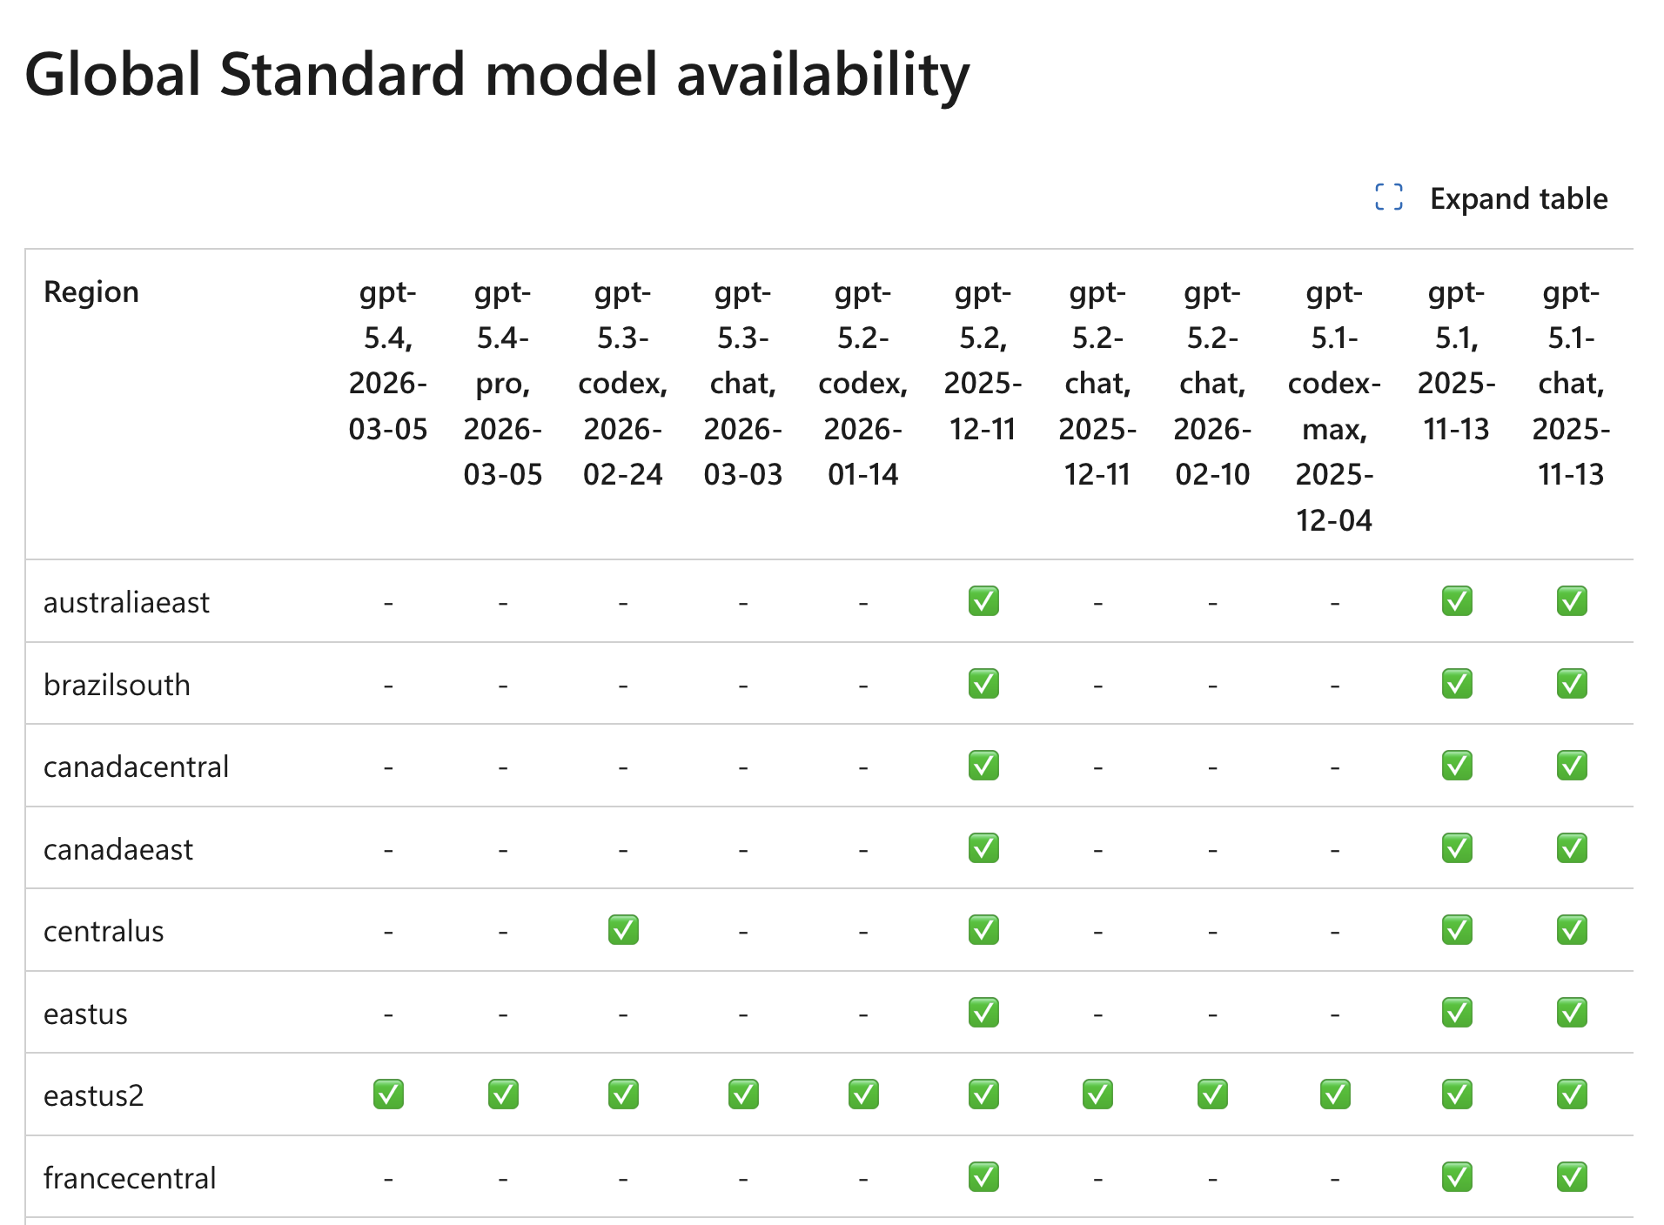
Model summary table and region availability
https://learn.microsoft.com/en-gb/azure/foundry/foundry-models/concepts/models-sold-directly-by-azure?tabs=global-standard-aoai%2Cglobal-standard&pivots=azure-openai#model-router

Slide 29
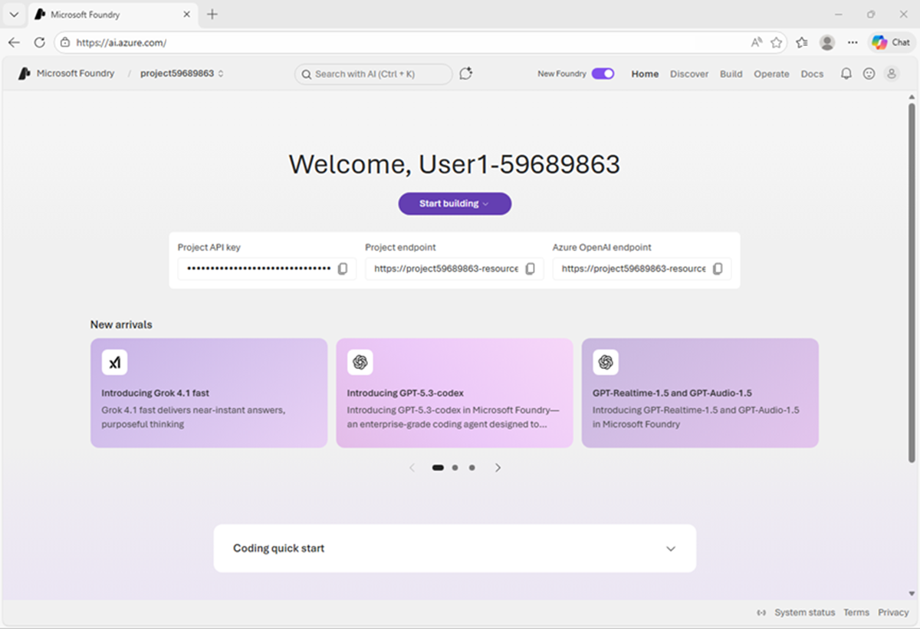

Slide 30
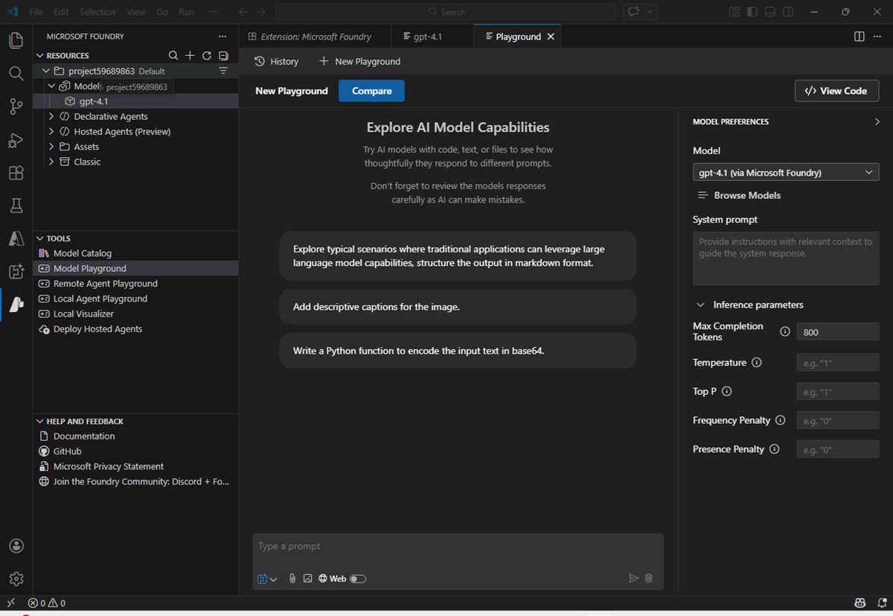

Slide 31
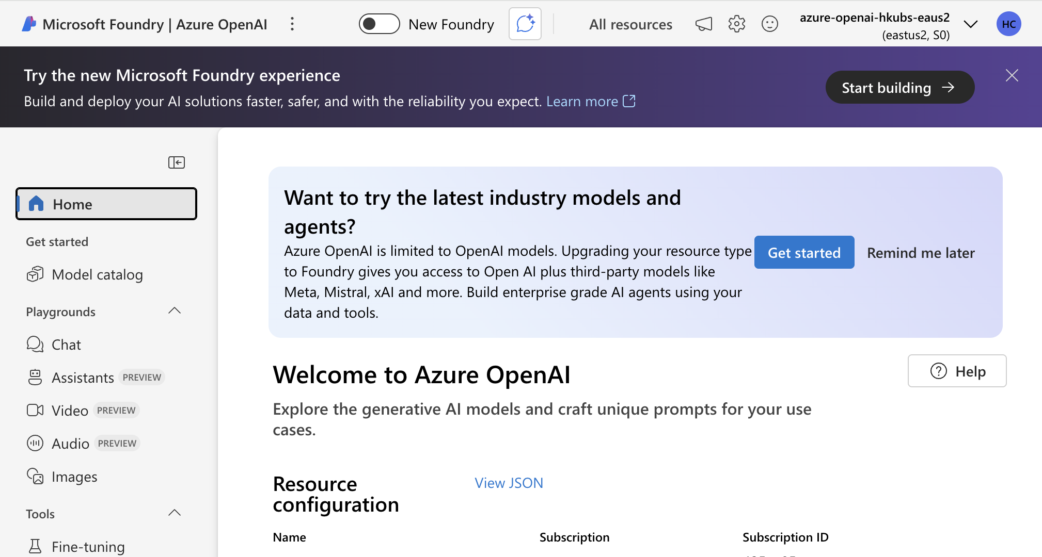

Slide 32
Assistants Playground
Azure OpenAI Assistants (Preview) allows you to create AI assistants tailored to your needs through custom instructions and augmented by advanced tools like code interpreter, and custom functions.
File search (RAG)
Code Interpreter
Functions

Slide 33


Integrated Development Environment Tools
PyCharm Community
Visual Studio Code

Slide 34
GitHub Copilot
Free for HKU Staff and Students
https://its.hku.hk/software/github-copilot/
User Guide: https://its.hku.hk/?wpdmdl=51459
AI-powered coding assistant
Code autocompletion in real-time
Supports multiple editors (VS Code, Visual Studio, JetBrains IDEs)

Slide 35
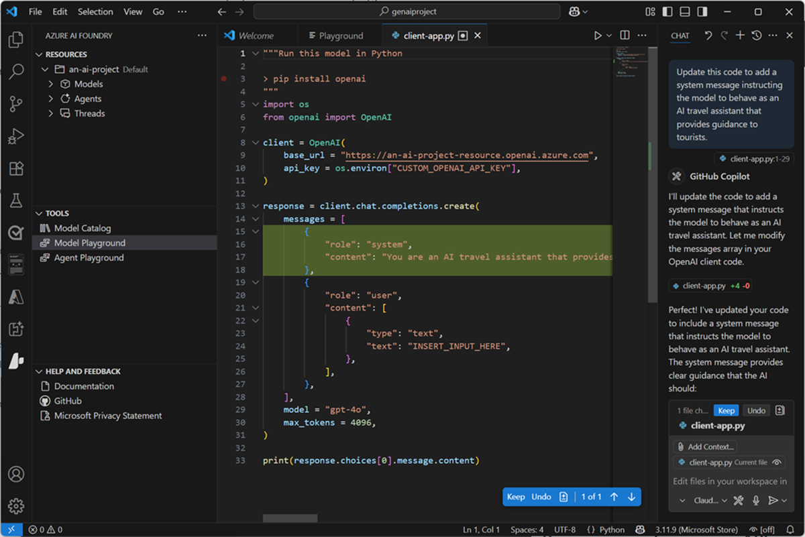

Slide 36
GitHub Codespaces
A cloud-based development environment accessible from your browser
Key Features:
Instant developer environments
Pre-configured setups
Accessible from any device
Integrated with GitHub
Benefits:
Saves time on setup
Increases productivity
Enables remote collaboration
Reduces hardware requirements

Slide 37
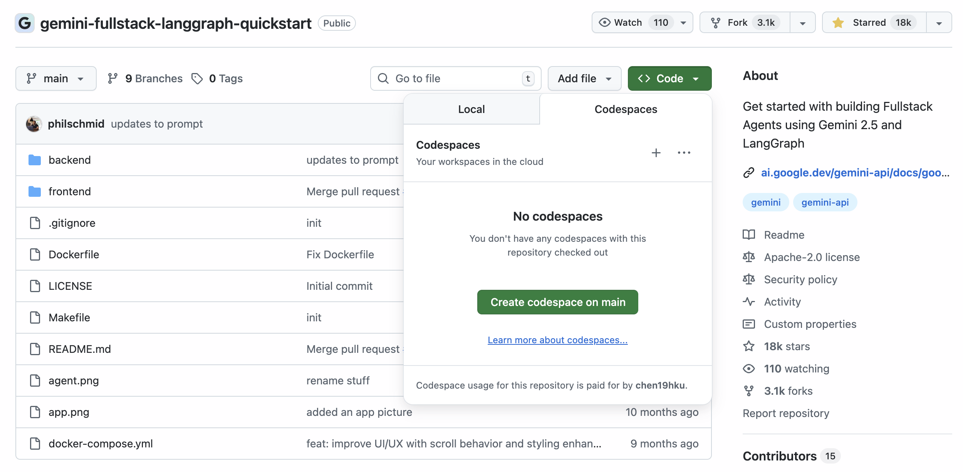

Slide 38

Three Generations of AI Development
Typically used to solve analytical tasks faster and more efficiently than humans (e.g., classify, evaluate, predict, or optimize)
Predict income
Sentiment analysis
Customer segmentation
Used to create new content (e.g., generating audio, code, images, text, and videos) and can use unstructured data more readily
Design concept
Create marketing copy
Generate code
Has the ability to plan and execute actions against defined objectives
Can use tools (e.g., web search, API calling, and other models or agents)
Deep research agent
Automate fraud investigations
Assist clients in complex processes (insurance claims)
Source: McKinsey & Company

Slide 39
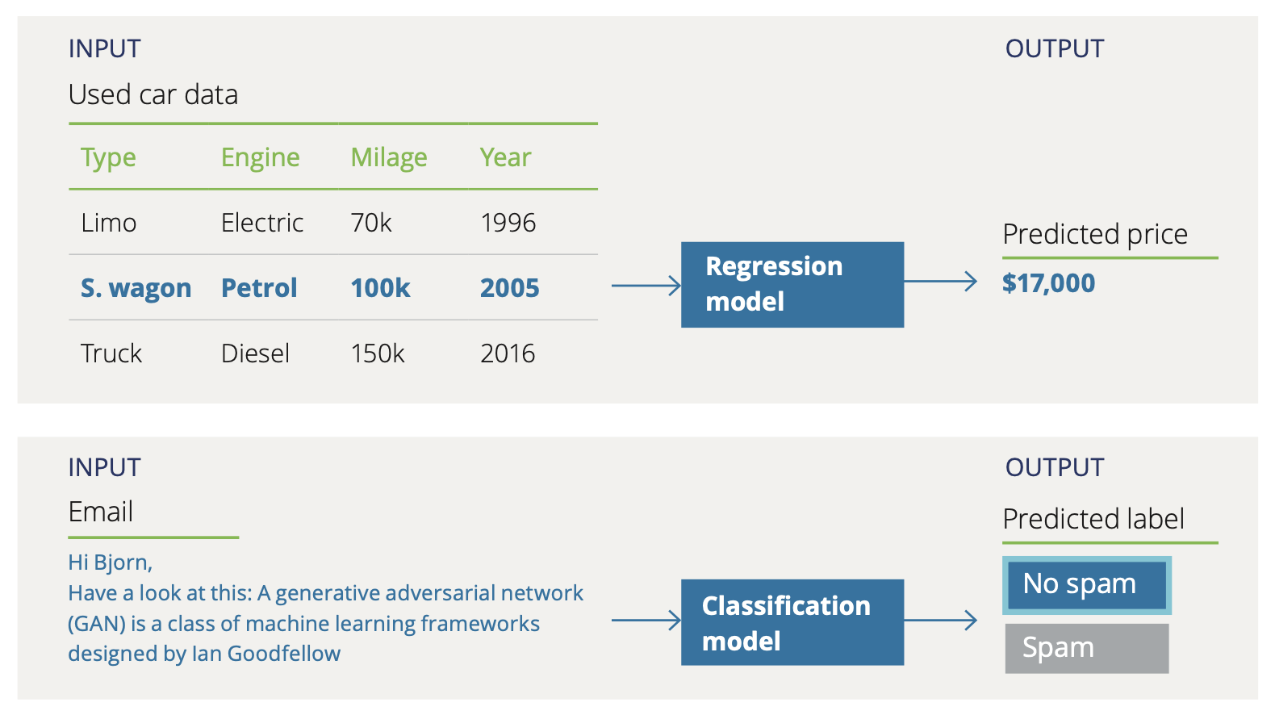
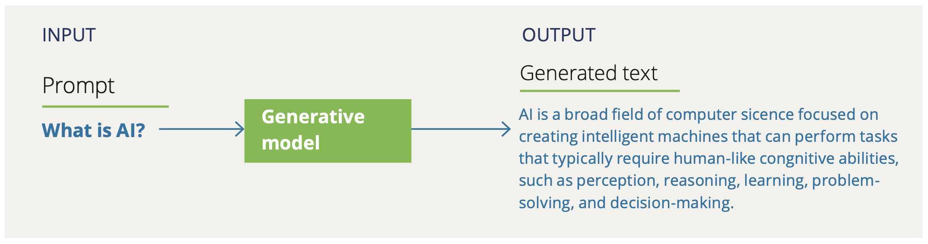
Traditional AI
(Non-generative AI /
Discriminative AI)
Generative AI
Source: Deloitte AI Institute

Slide 40
How LLMs Work
Step | Current Sentence | Model Output
1 | The cat sat on the | mat
2 | The cat sat on the mat | and
3 | The cat sat on the mat and | looked
4 | The cat sat on the mat and looked | around
5 | The cat sat on the mat and looked around | curiously
6 | The cat sat on the mat and looked around curiously | at
7 | The cat sat on the mat and looked around curiously at | the
8 | The cat sat on the mat and looked around curiously at the | birds
9 | The cat sat on the mat and looked around curiously at the birds | flying

Slide 41
Word Prediction with Probabilities
Current Sentence | Potential Next Words | Probabilities | Model Output
The cat sat on the mat and looked | around | 0.35 | around
 | curiously | 0.25
 | quickly | 0.15
 | lazily | 0.10
 | intently | 0.05
 | at | 0.05
 | outside | 0.05

Slide 42
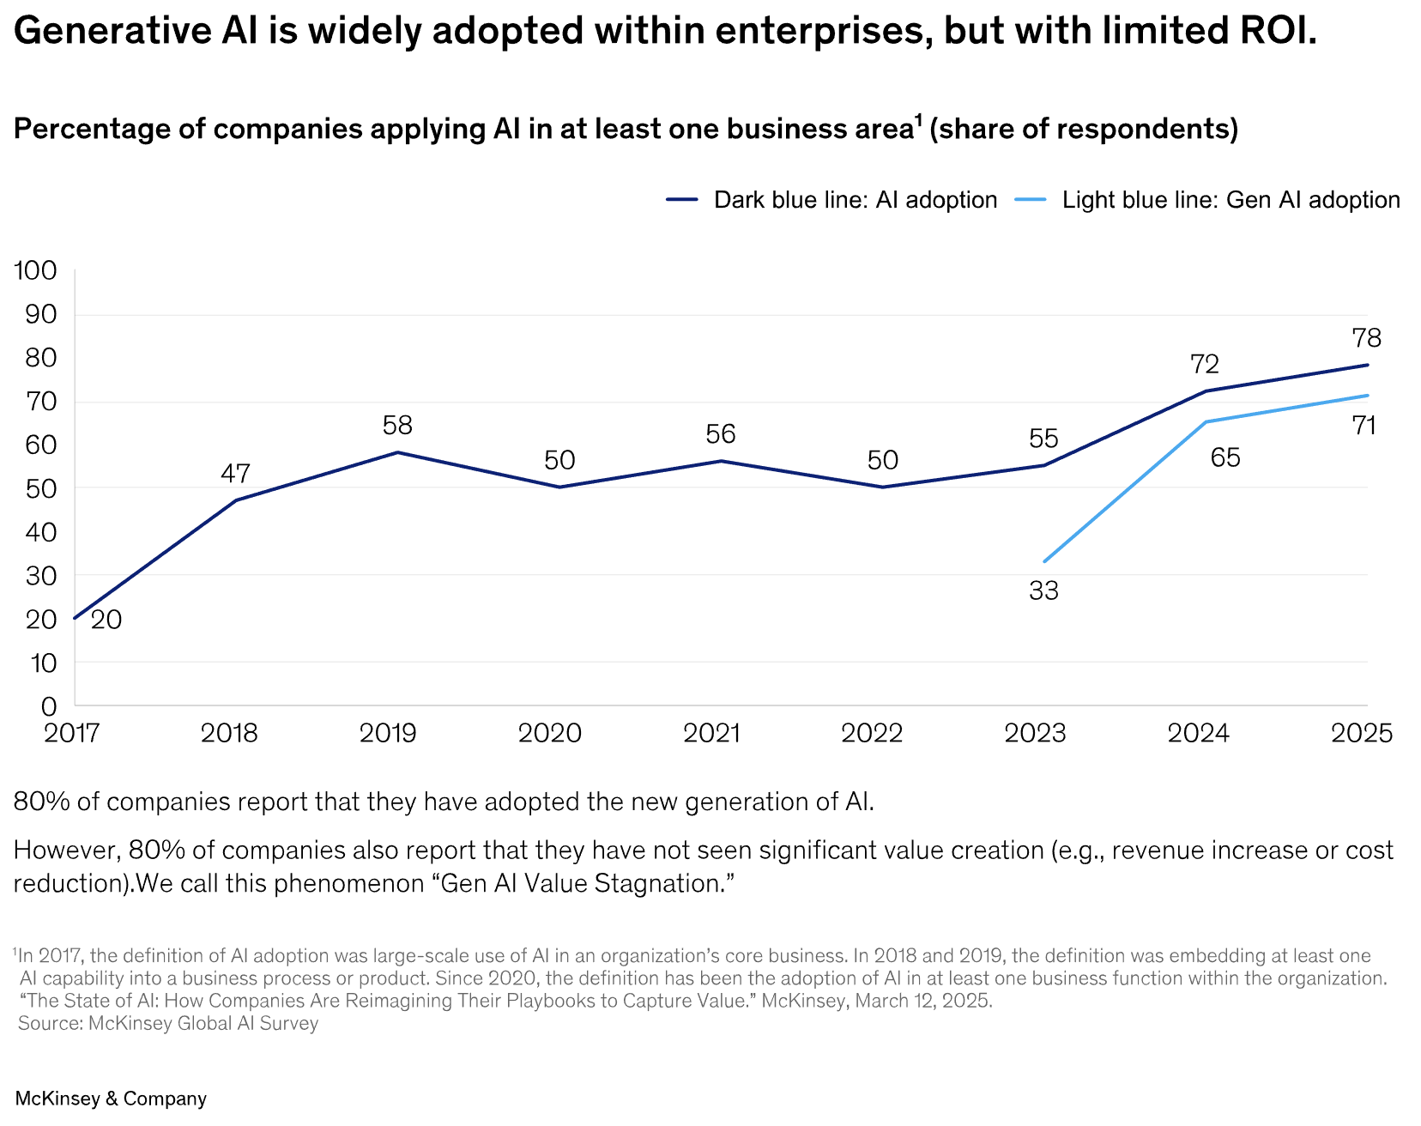

Slide 43
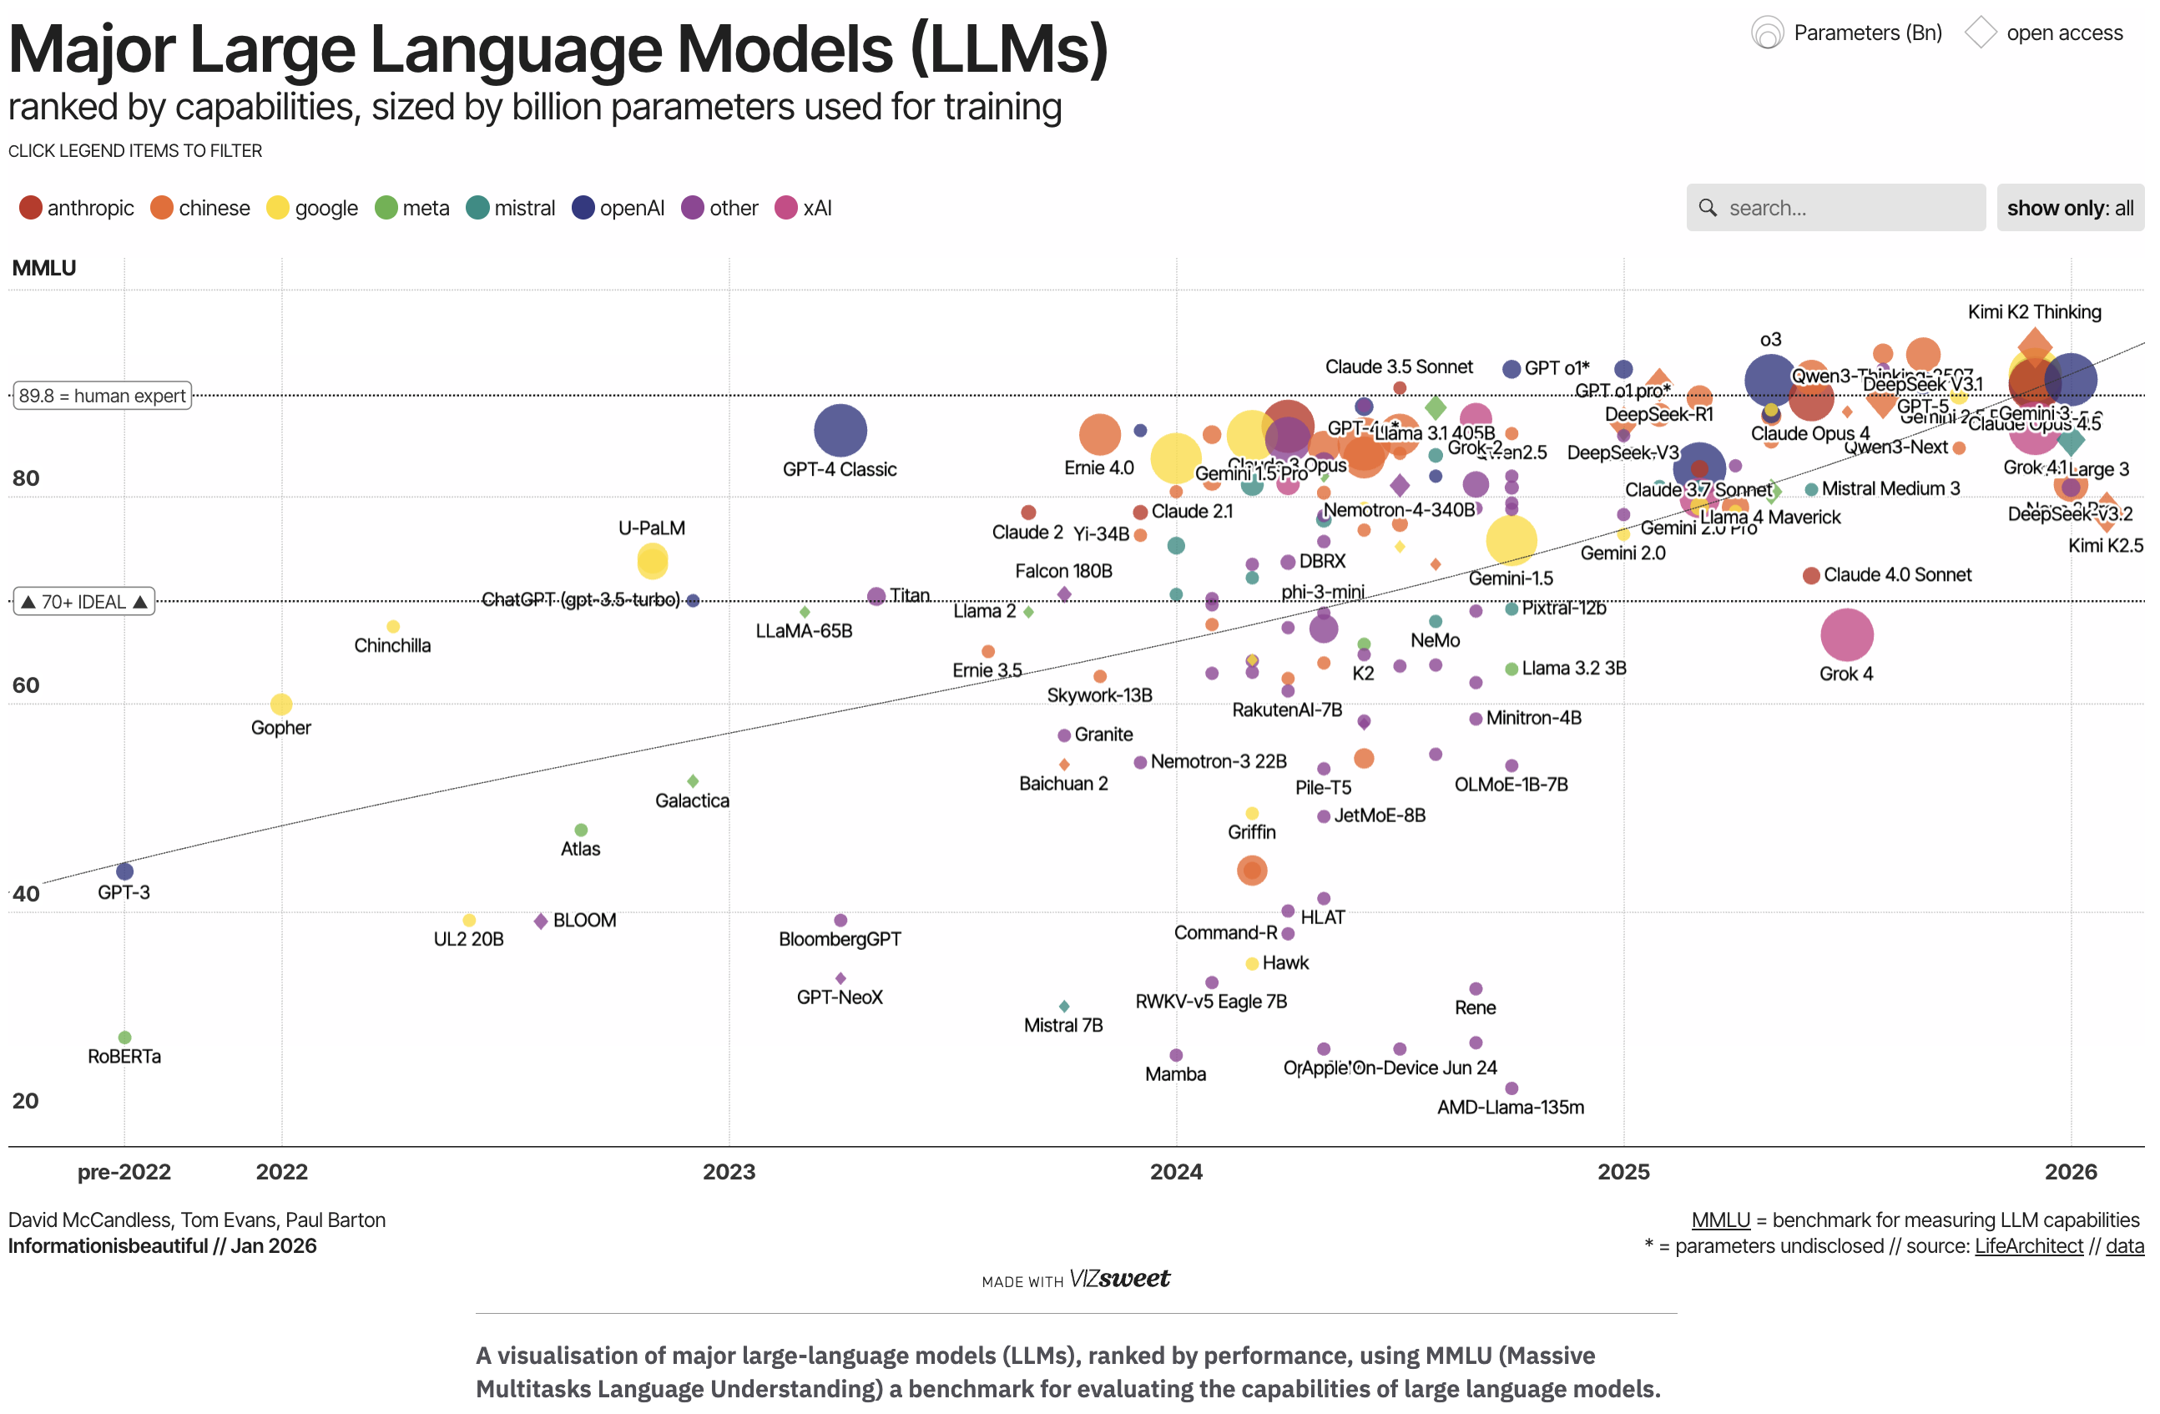
Notes:
https://informationisbeautiful.net/visualizations/the-rise-of-generative-ai-large-language-models-llms-like-chatgpt/

Slide 44
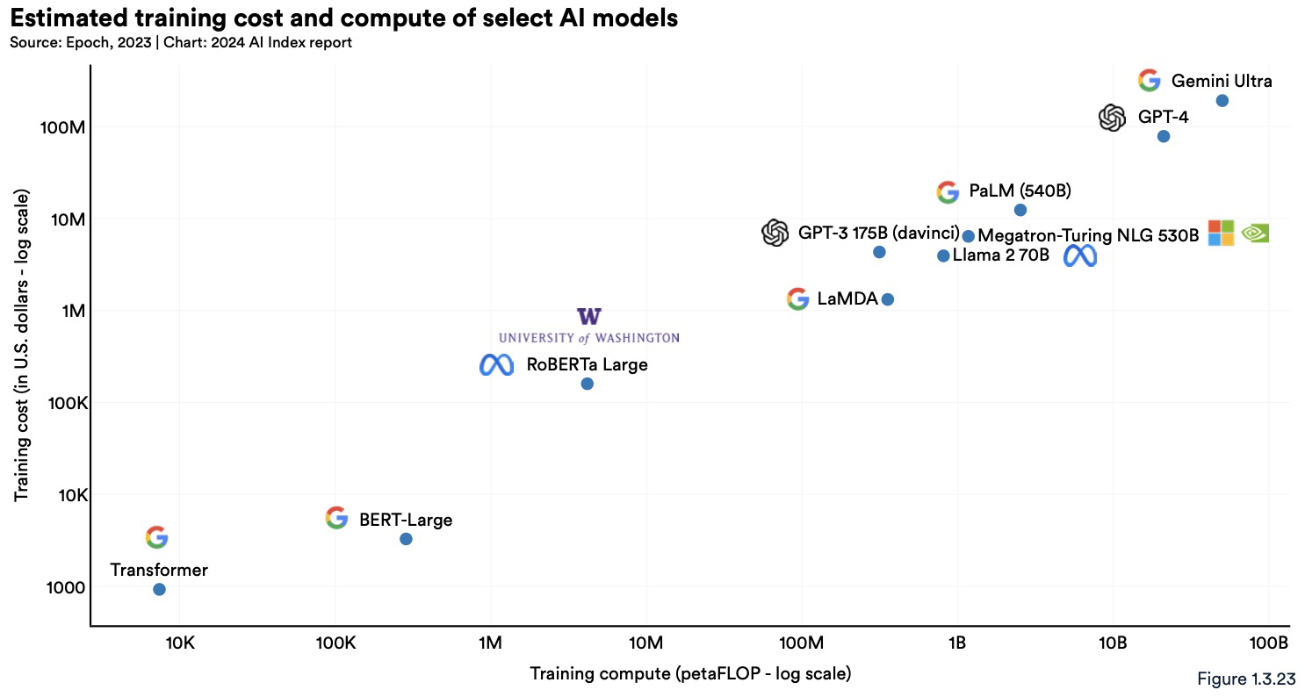

Slide 45
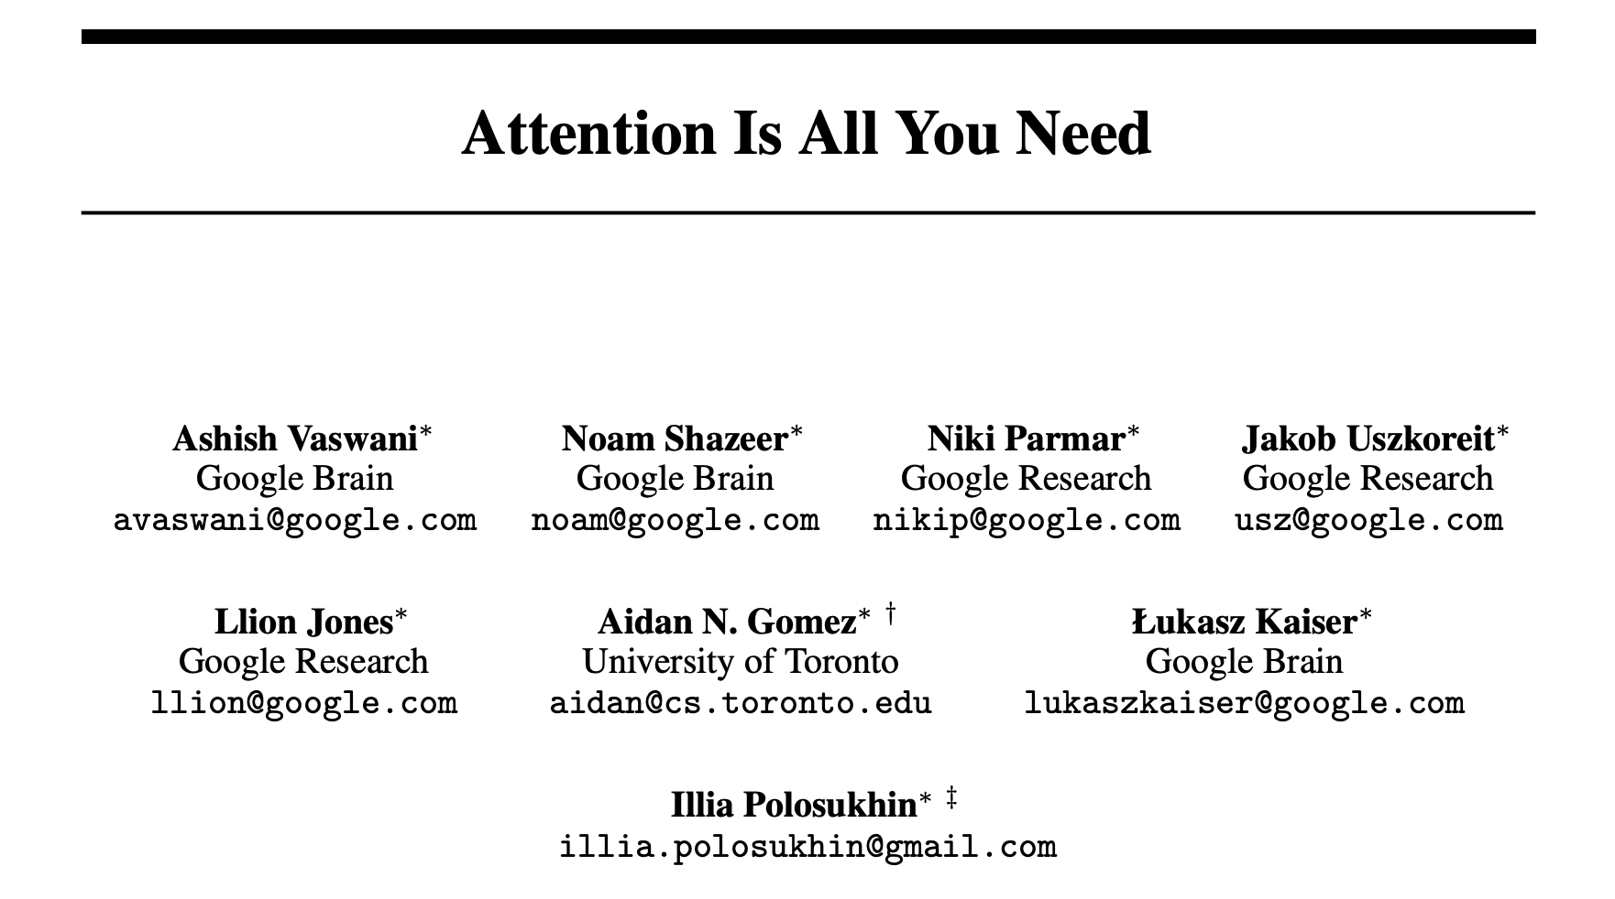

Slide 46
Transformer Model (2017)
Revolutionary NLP model
Self-attention mechanism
Parallel processing
State-of-the-art performance

Slide 47
Transformer Model Architecture
Transformer model architecture consists of two components, or blocks:
An encoder block that creates semantic representations of the training vocabulary.
A decoder block that generates new language sequences.
Source: Microsoft Learn

Slide 48
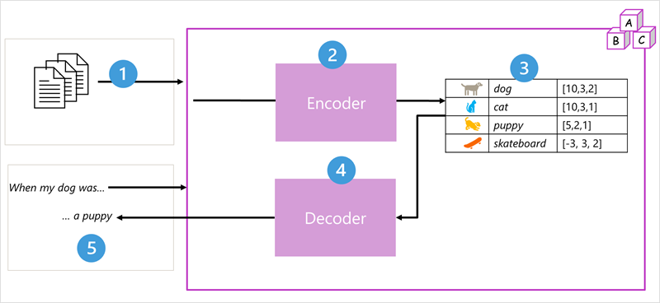
Transformer Models
Source: Microsoft Learn

Slide 49
Transformer Models
The model is trained using extensive natural language text.
Text sequences are tokenized and processed using attention to identify relationships between tokens.
The encoder generates embeddings, representing semantic attributes of tokens.
The decoder uses these embeddings to produce coherent natural language output.
For instance, given the input "When my dog was," the model can predict an appropriate continuation like "a puppy."

Slide 50
Tokenization
The first step in training a transformer model is to decompose the training text into tokens - in other words, identify each unique text value.
“I heard a dog bark loudly at a cat” can be represented with the tokens: {1 2 3 4 5 6 7 3 8}
- I (1)
- heard (2)
- a (3)
- dog (4)
- bark (5)
- loudly (6)
- at (7)
- *("a" is already tokenized as 3)*
- cat (8)
Source: Microsoft Learn

Slide 51
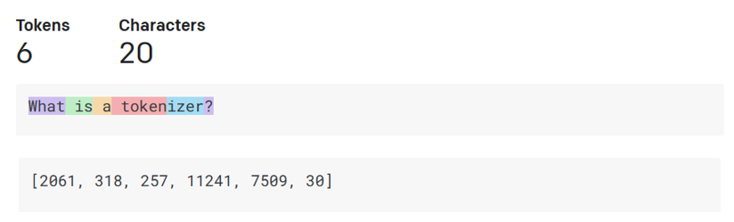
Tokenization
Tokens are common sequences of characters found in a set of text.
A tokenizer is used to split an input text into an array of tokens.
The exact tokenization process varies between models.
Each token is mapped with a token index, which is the integer encoding of the original text chunk.
One token generally corresponds to ~4 characters of text for common English text. This translates to roughly ¾ of a word (so 100 tokens ~= 75 words).
Source: https://platform.openai.com/tokenizer

Slide 52
Attention
Attention is a technique used to examine a sequence of text tokens and try to quantify the strength of the relationships between them.
In particular, self-attention involves considering how other tokens around one particular token influence that token's meaning.
Source: Microsoft Learn

Slide 53
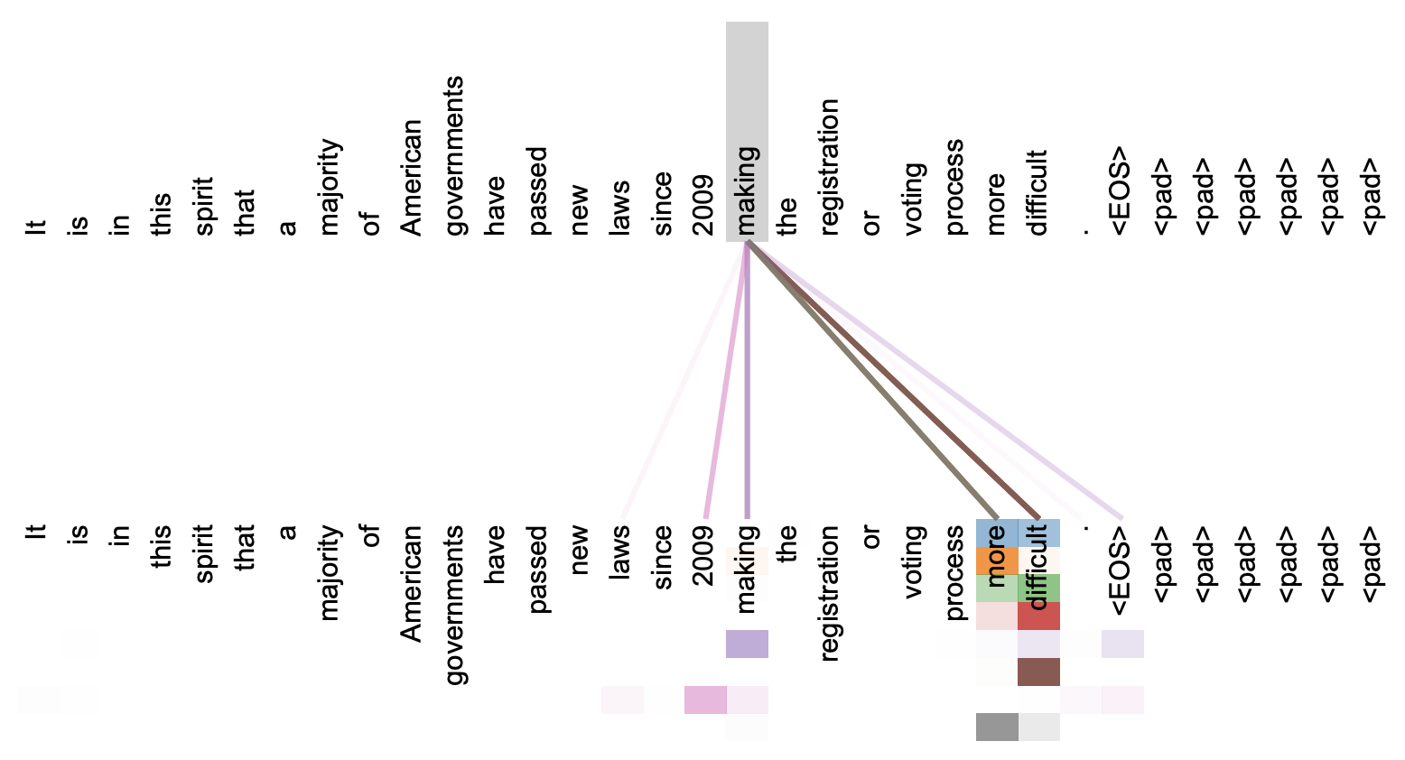
Attention: making … more difficult
Source: Attention is All You Need

Slide 54
Embeddings
While it may be convenient to represent tokens as simple IDs - essentially creating an index for all the words in the vocabulary, they don't tell us anything about the meaning of the words, or the relationships between them.
To create a vocabulary that encapsulates semantic relationships between the tokens, we define contextual vectors, known as embeddings, for them.
Vectors are multi-valued numeric representations of information, for example [10, 3, 1] in which each numeric element represents a particular attribute of the information.
Vectors represent lines in multidimensional space, describing direction and distance (or amplitude and magnitude) along multiple axes.
Source: Microsoft Learn

Slide 55

Embeddings
4 ("dog"): [10,3,2]
8 ("cat"): [10,3,1]
9 ("puppy"): [5,2,1]
10 ("skateboard"): [-3,3,2]
Semantically similar tokens point in the same direction.
Source: Microsoft Learn

Slide 56
 | Bidirectional Encoder Representations from Transformers (BERT) | Generative Pre-trained Transformer (GPT)
Type | Encoder-only model | Decoder-only model
Processing | Bidirectional | Unidirectional
Focus | Understanding context and relationships in text | Generating coherent and contextually relevant text
Use Cases | Natural language understanding tasks (e.g., question answering, sentiment analysis) | Natural language generation tasks (e.g., text completion, creative writing)

Slide 57
Large Language Models (LLMs) | Small Language Models (SLMs)
Trained with a vast amount of text on various subjects. | Trained with smaller, focused datasets.
Have billions to trillions of parameters. | Have fewer parameters than LLMs.
Good at general language generation. | Effective in specific topics, less so in general language.
Large size can affect performance and local deployment. | Smaller size is better for local deployment and quicker fine-tuning.
Fine-tuning is time-consuming and costly. | Fine-tuning is less time-consuming and costly.

Slide 58
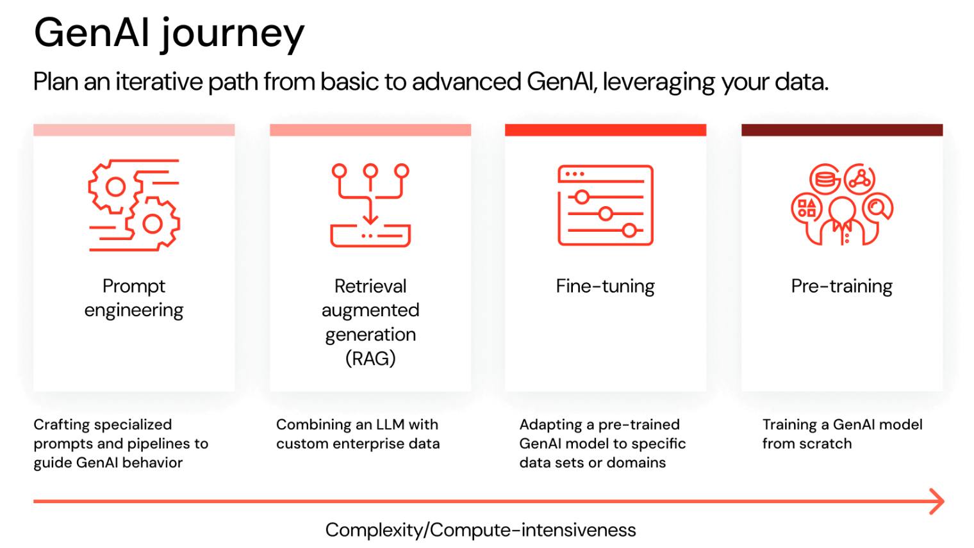
Source: Databricks

Slide 59
LLM Key Technologies
Prompt Engineering
Function Calling
Retrieval-Augmented Generation (RAG)
Fine-Tuning Large Language Models
Reasoning
Code Interpreter
AI Agent

Slide 60
Prompts and Completions
GPT-4
1+1=?
1+1=2
Which year is it?
It is currently 2025.
Source: DeepLearning.AI / AWS

Slide 61
LLM Use Cases and Tasks
Source: DeepLearning.AI / AWS

Slide 62
Information Extraction with LLM
prompt = f"""Summarize the events mentioned in the following news article delimited by triple backticks in the format of JSONL. An event describes something that happened that could cause the price of an asset to change. Some examples of an asset include stock, bond, sector, gold, and overall market. Federal Reserve is not an asset. The fields for the JSONL file include "date", which is the date of the event; "event_cause", which describes the plausible cause of an asset's price change in one or a few sentences; "asset", which is an individual asset affected by the event cause; "price_movement", which represents the direction of the price change of the asset and equals UP if the price increases/jumps/rises/goes up or DOWN if the price decreases/goes down; and "percentage_change", which describes the magnitude of the price_movement. ```{title} {subheadline} {date} {news}``` """

Slide 63
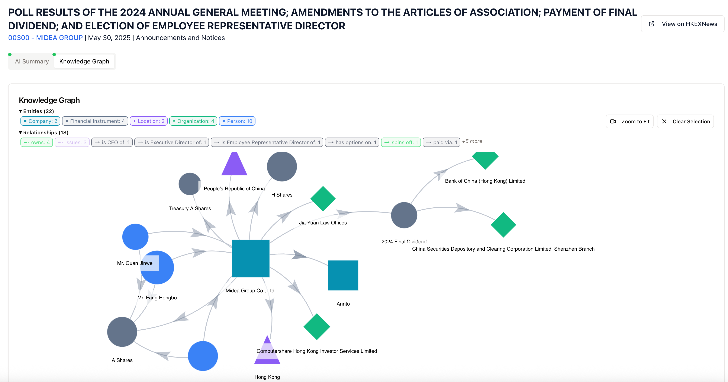
Source: https://hk.filingsai.org/filings/33492

Slide 64
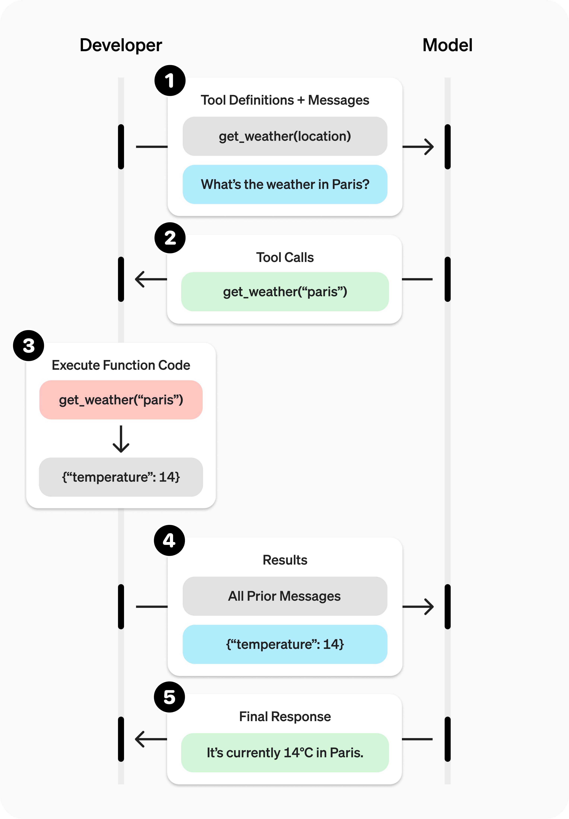
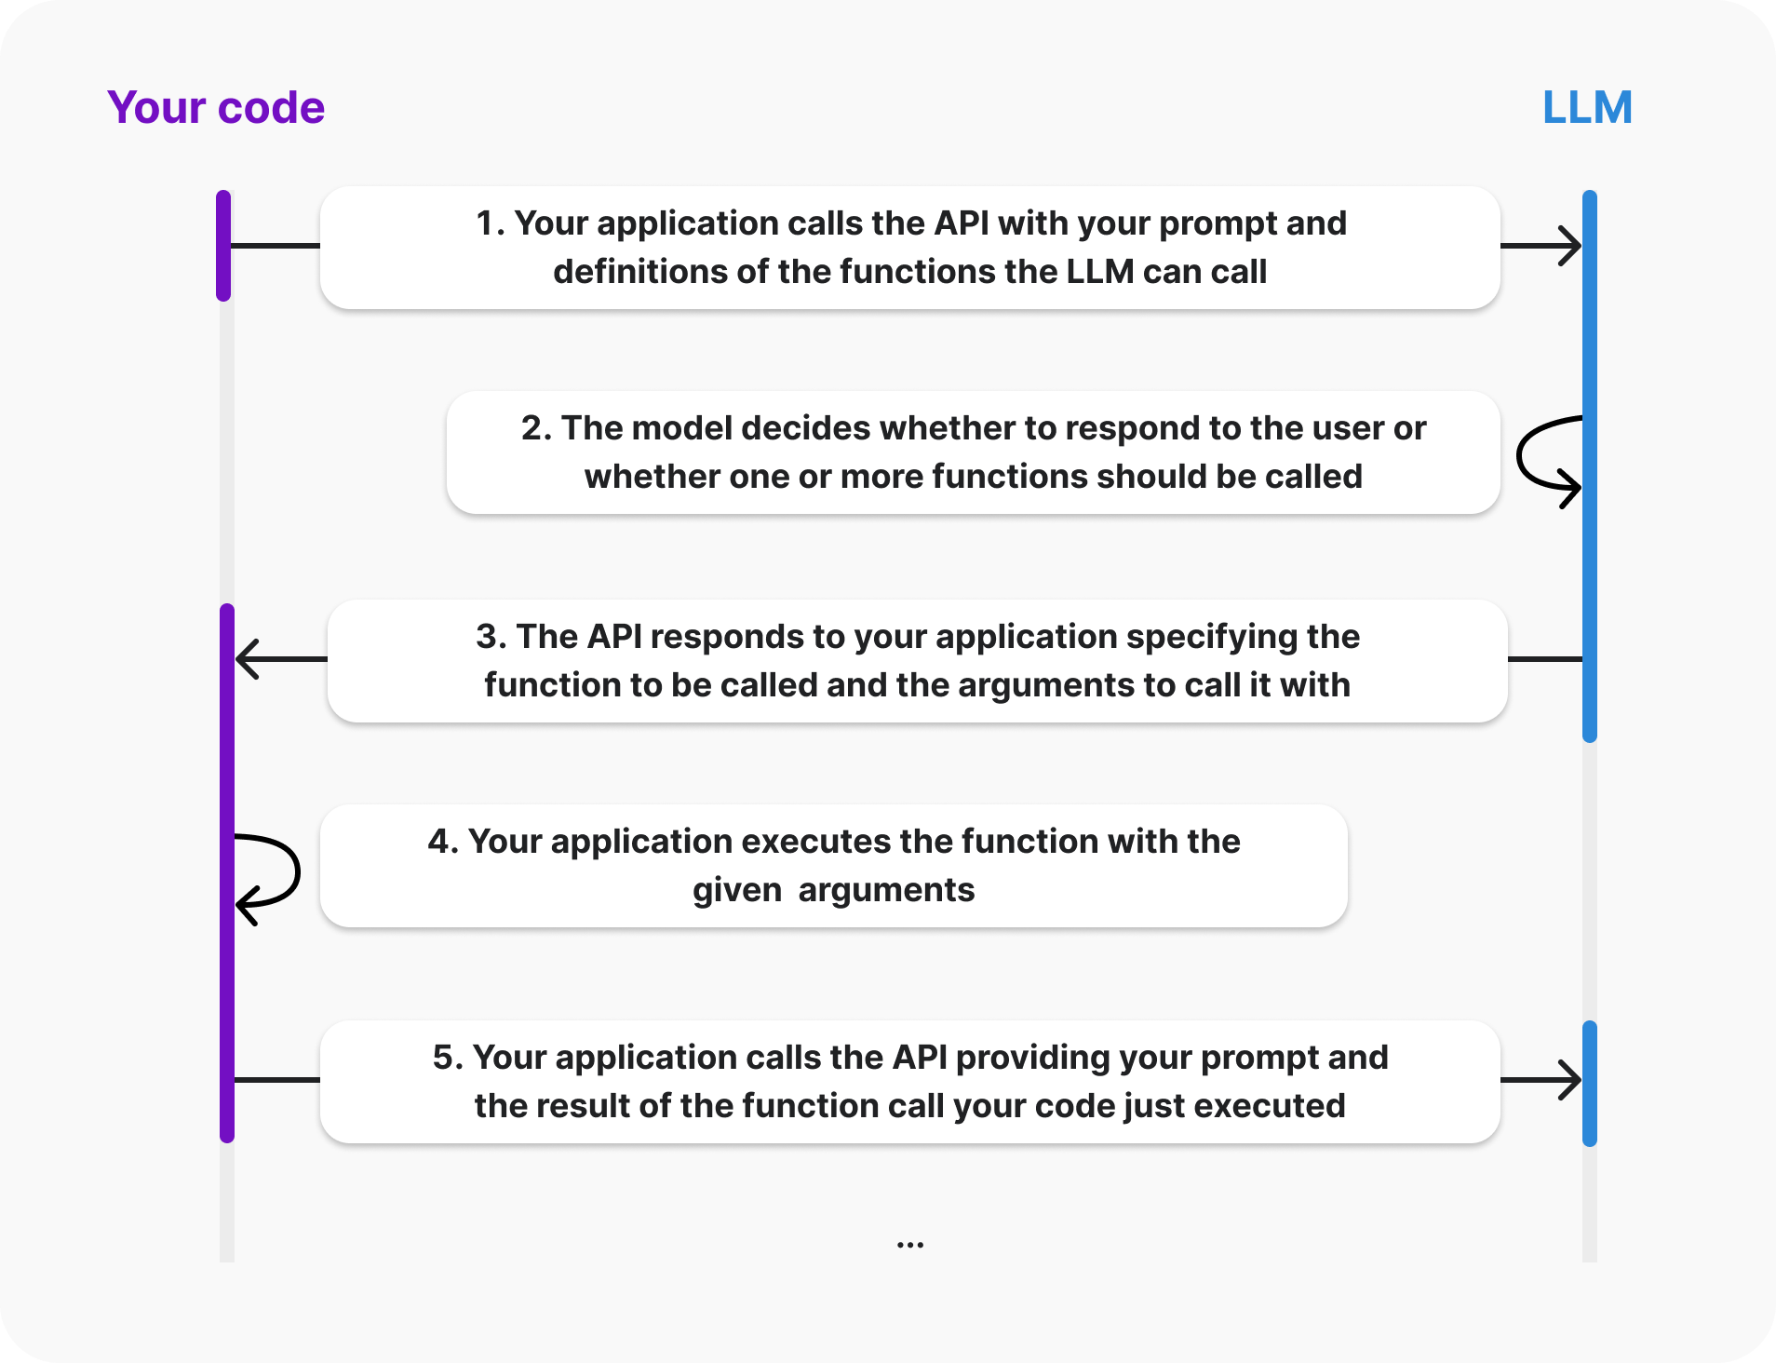
Function Calling

Slide 65
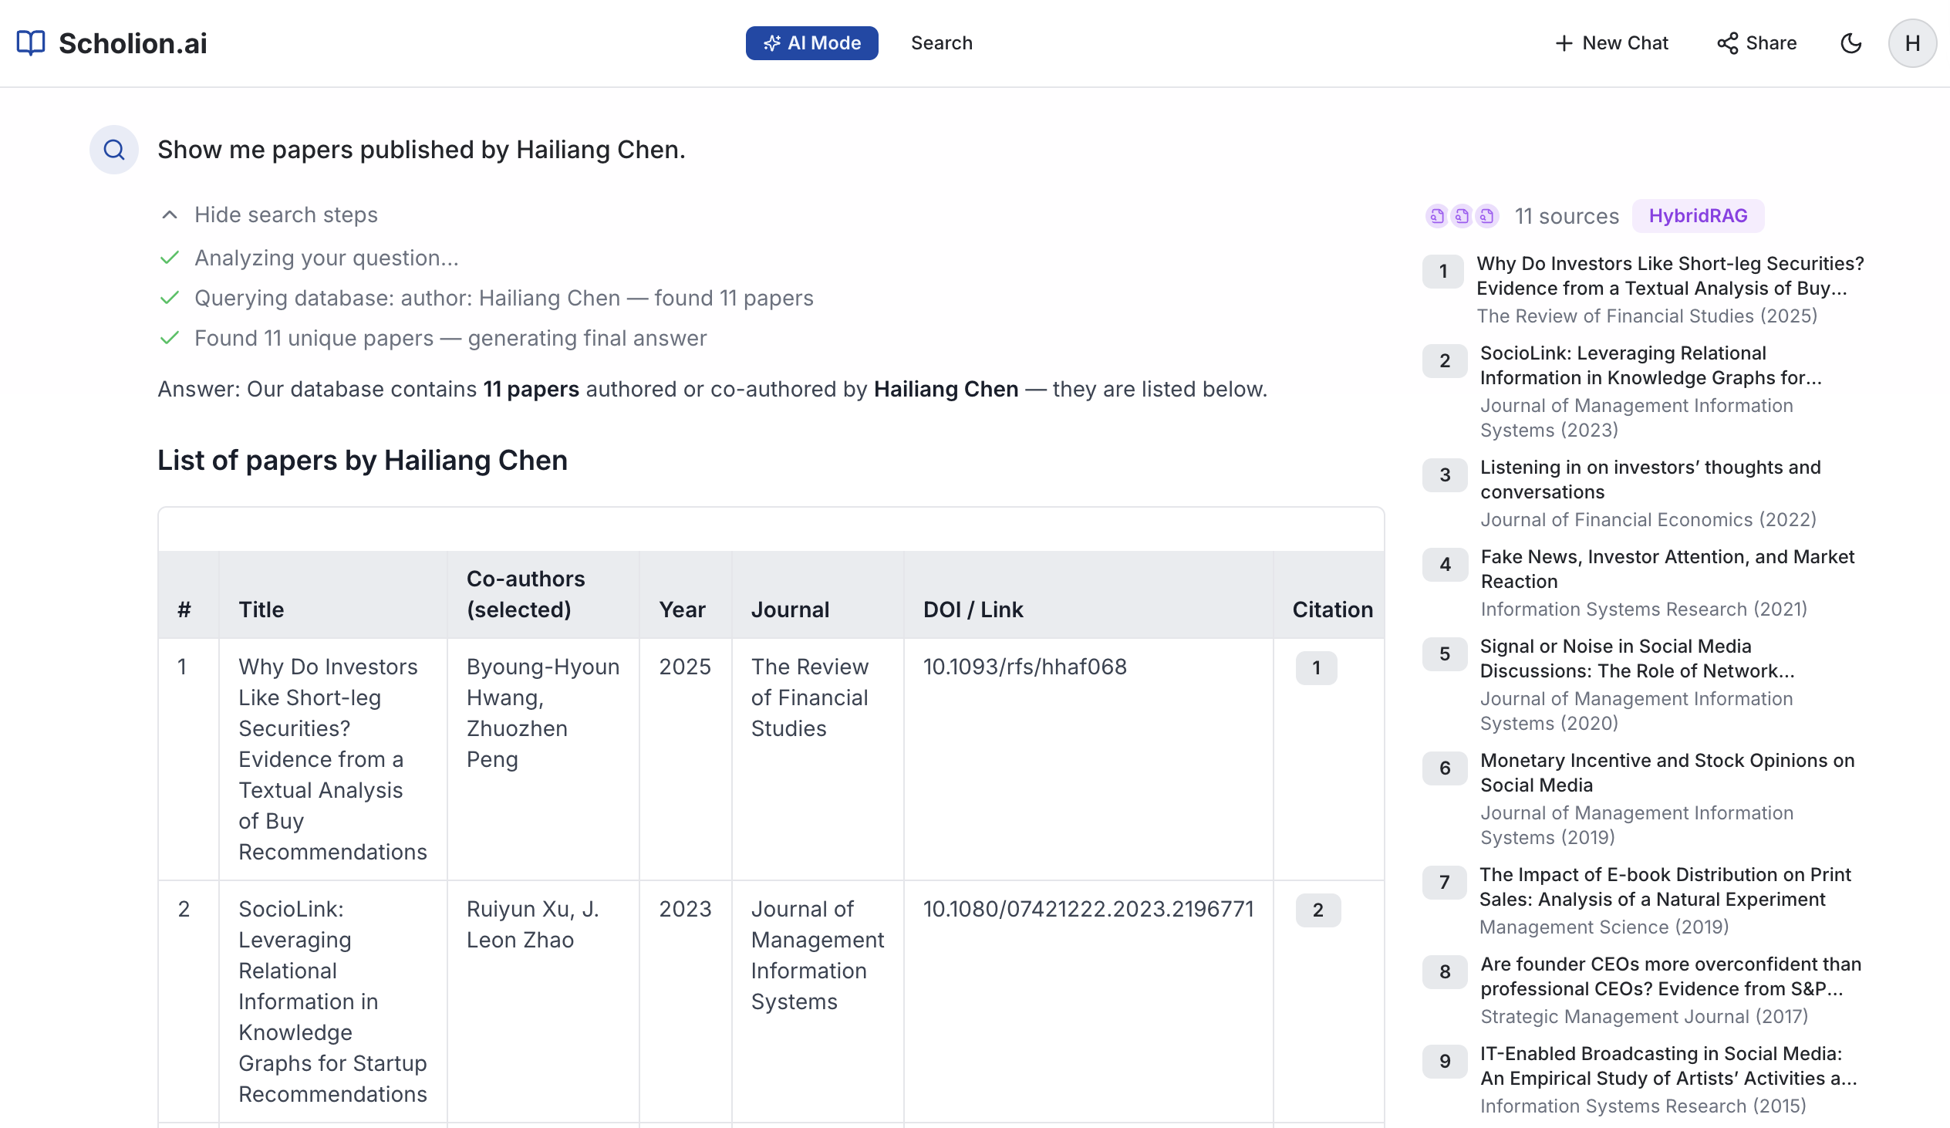
Function Calling + Database

Slide 66
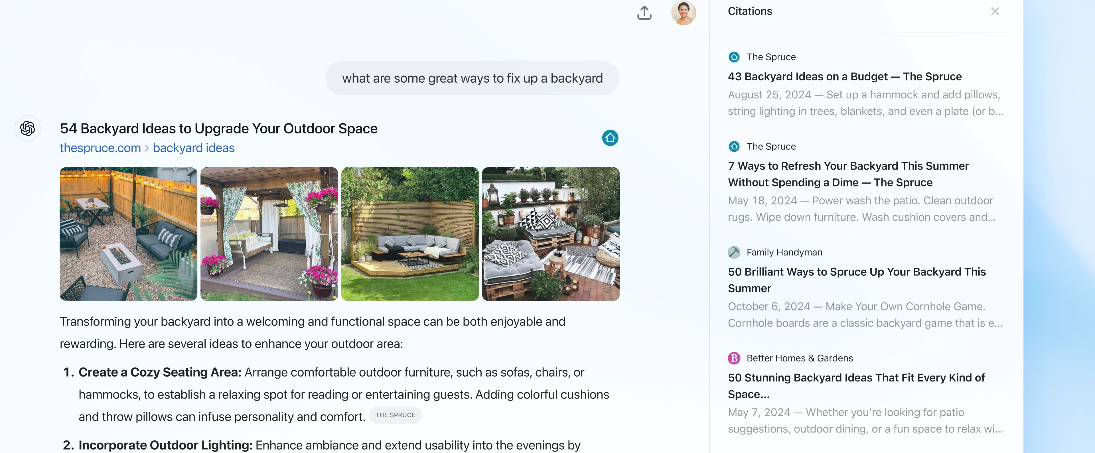
OpenAI ChatGPT Search

Slide 67
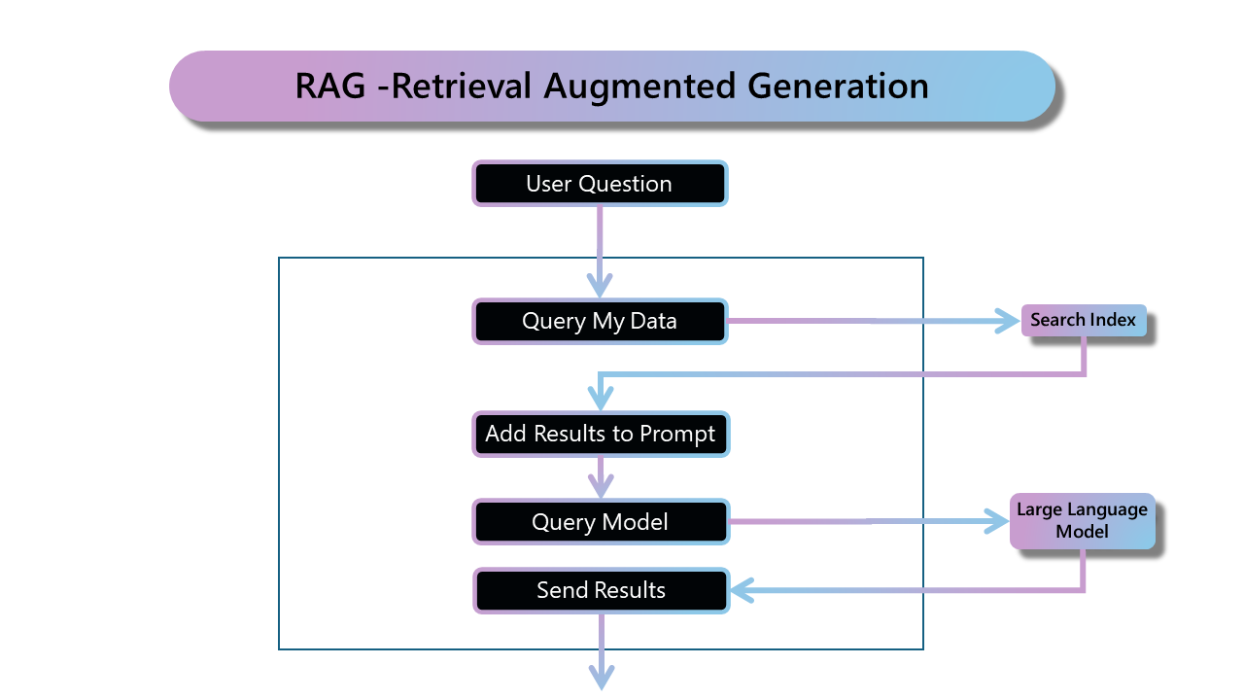

Slide 68
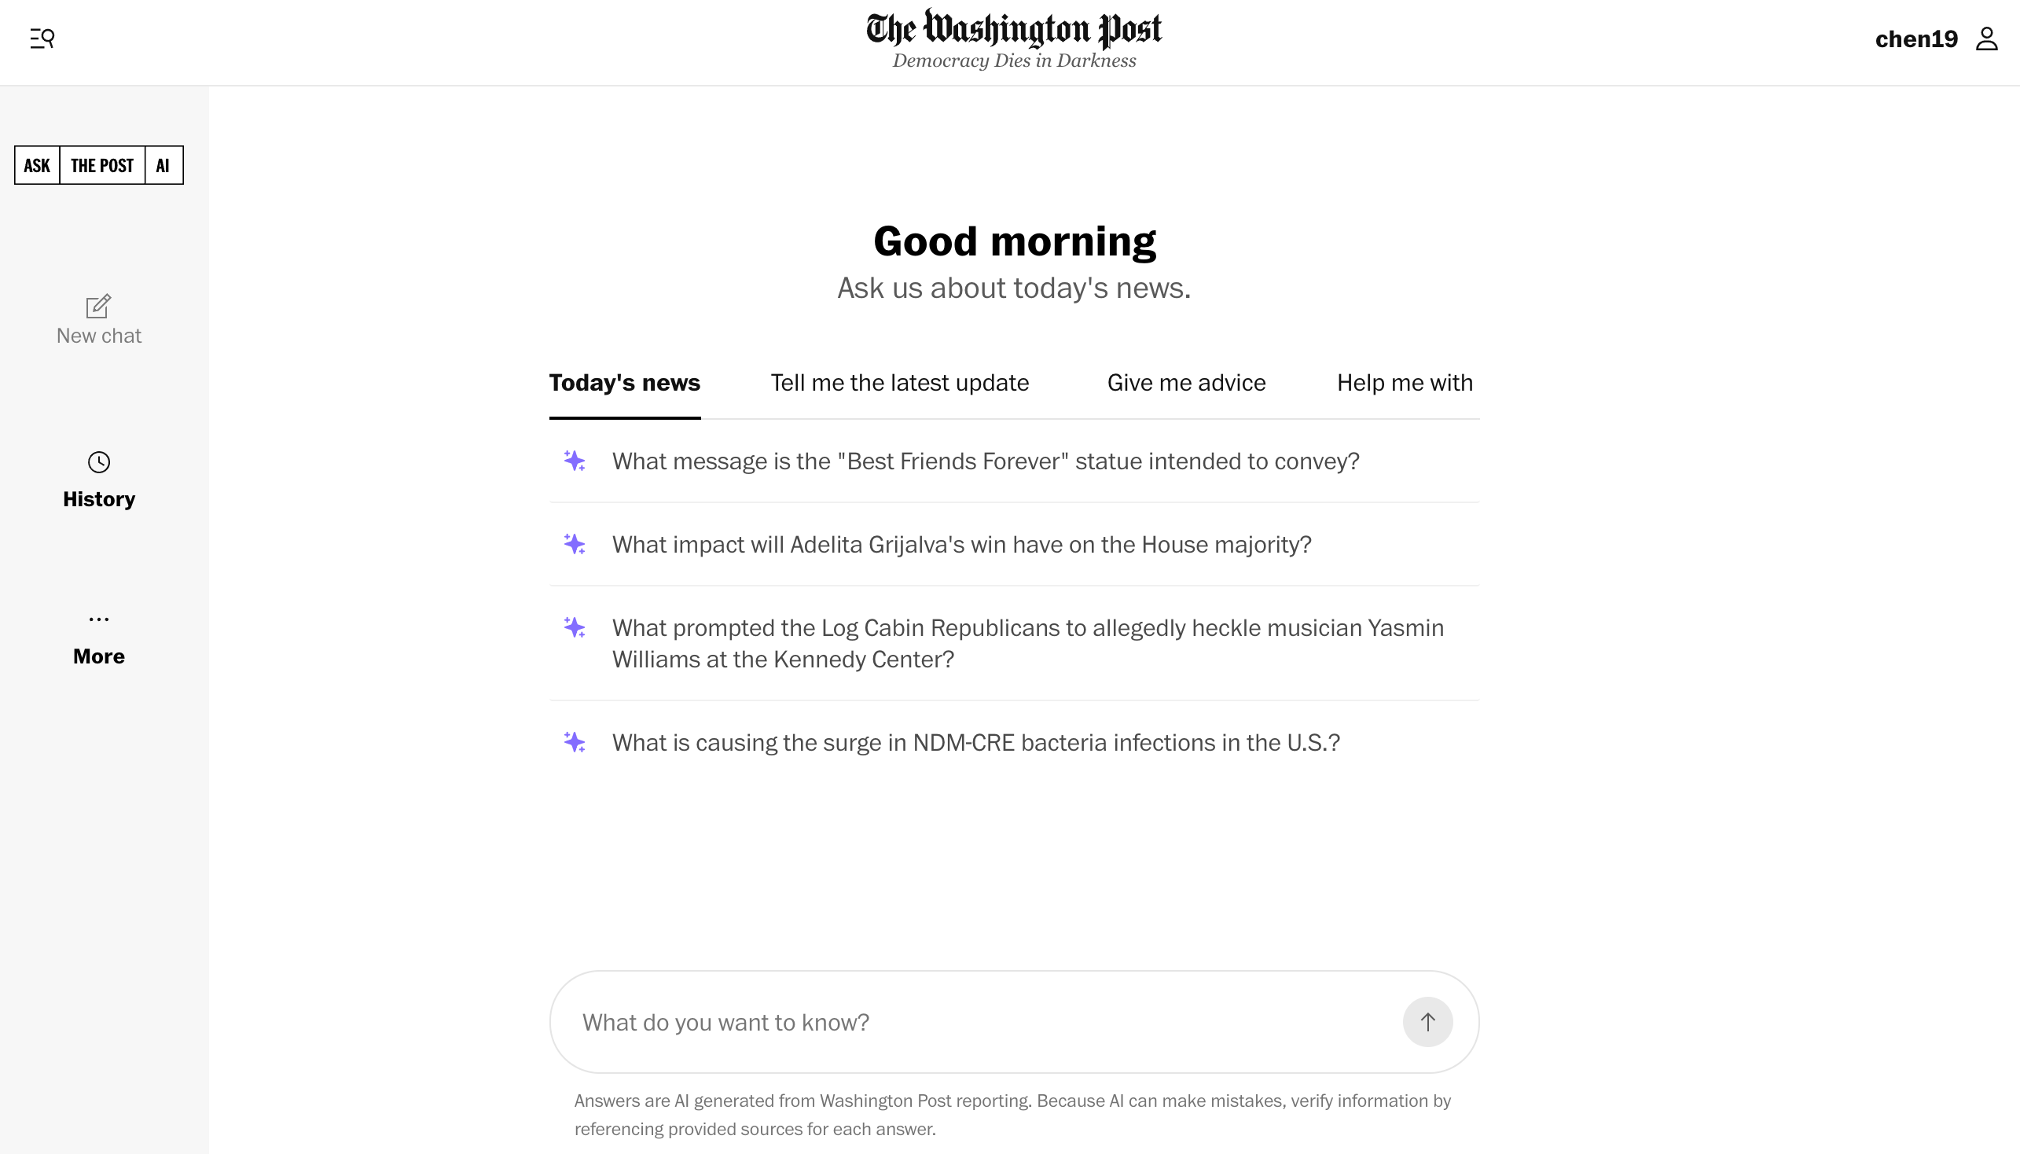

Slide 69
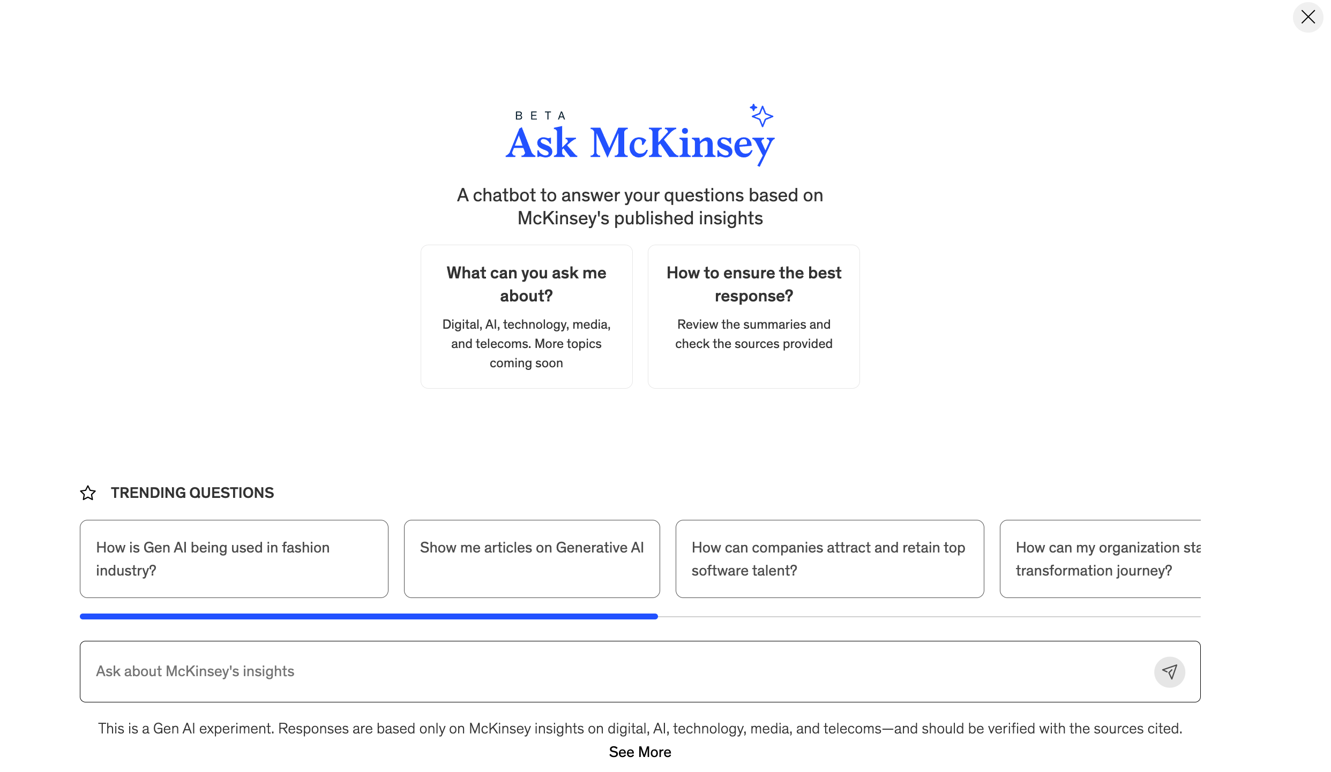

Slide 70
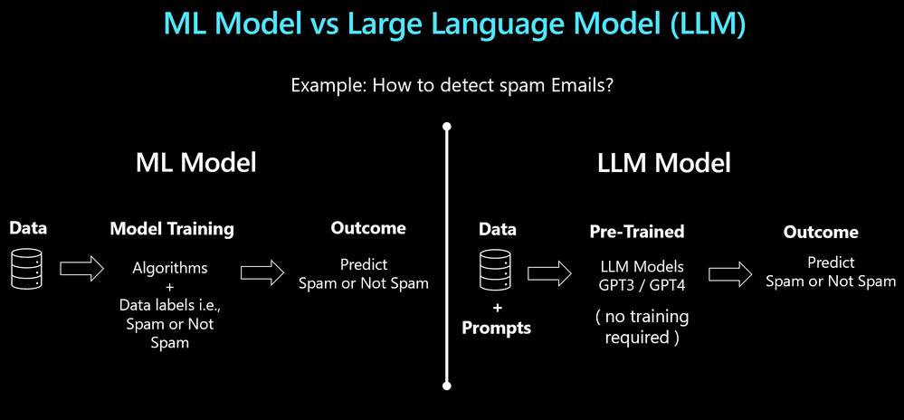
ML vs. LLM
Source: Microsoft

Slide 71
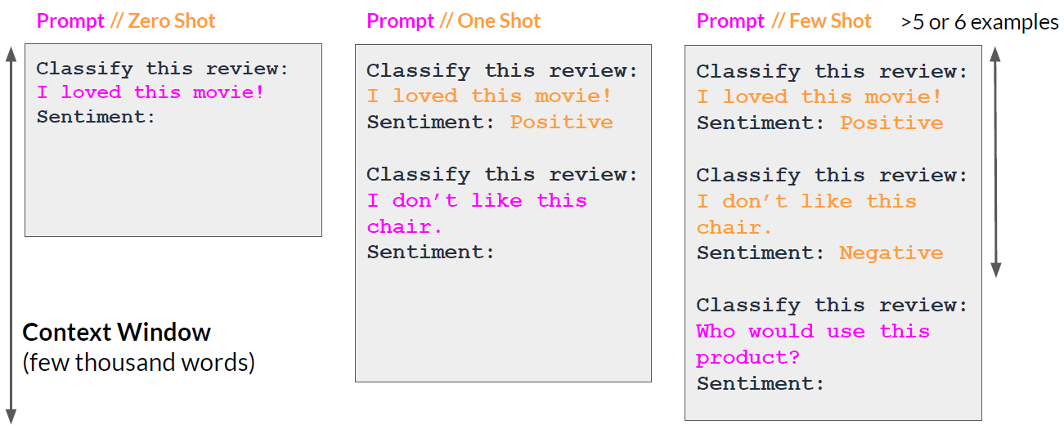
In-context Learning

Slide 72
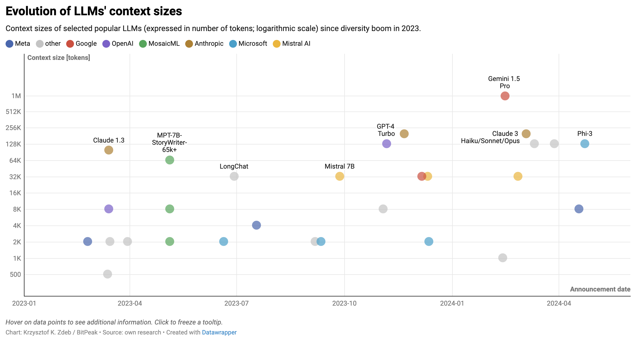
Notes:
https://www.datawrapper.de/_/UyC7R/
https://towardsdatascience.com/towards-infinite-llm-context-windows-e099225abaaf

Slide 73
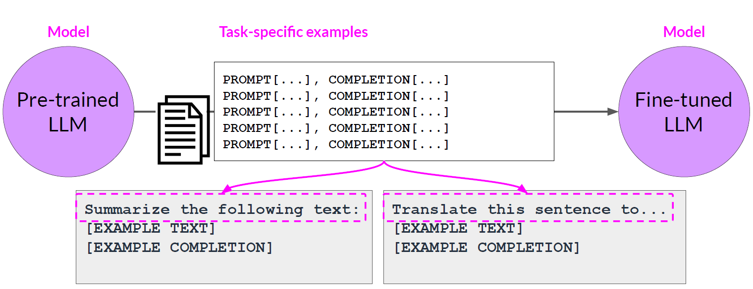
Fine-Tuning Large Language Models
Source: DeepLearning.AI / AWS

Slide 74
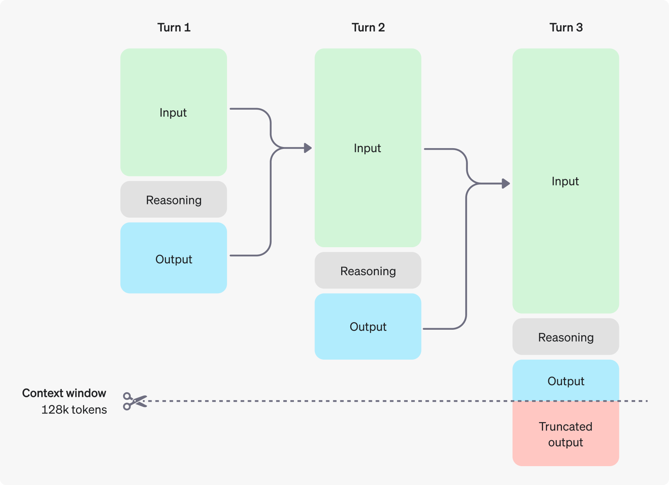
Reasoning Model

Slide 75
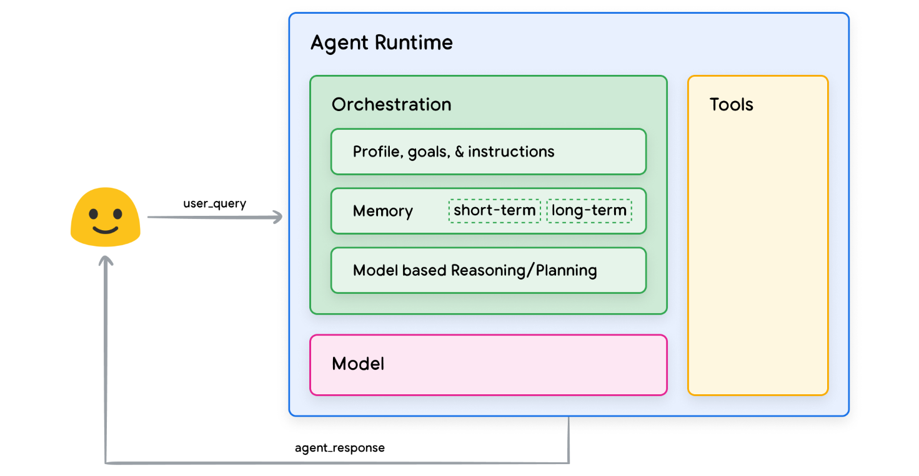
Agent
Source: Google

Slide 76

Introducing: Deep Research on Perplexity

Slide 77
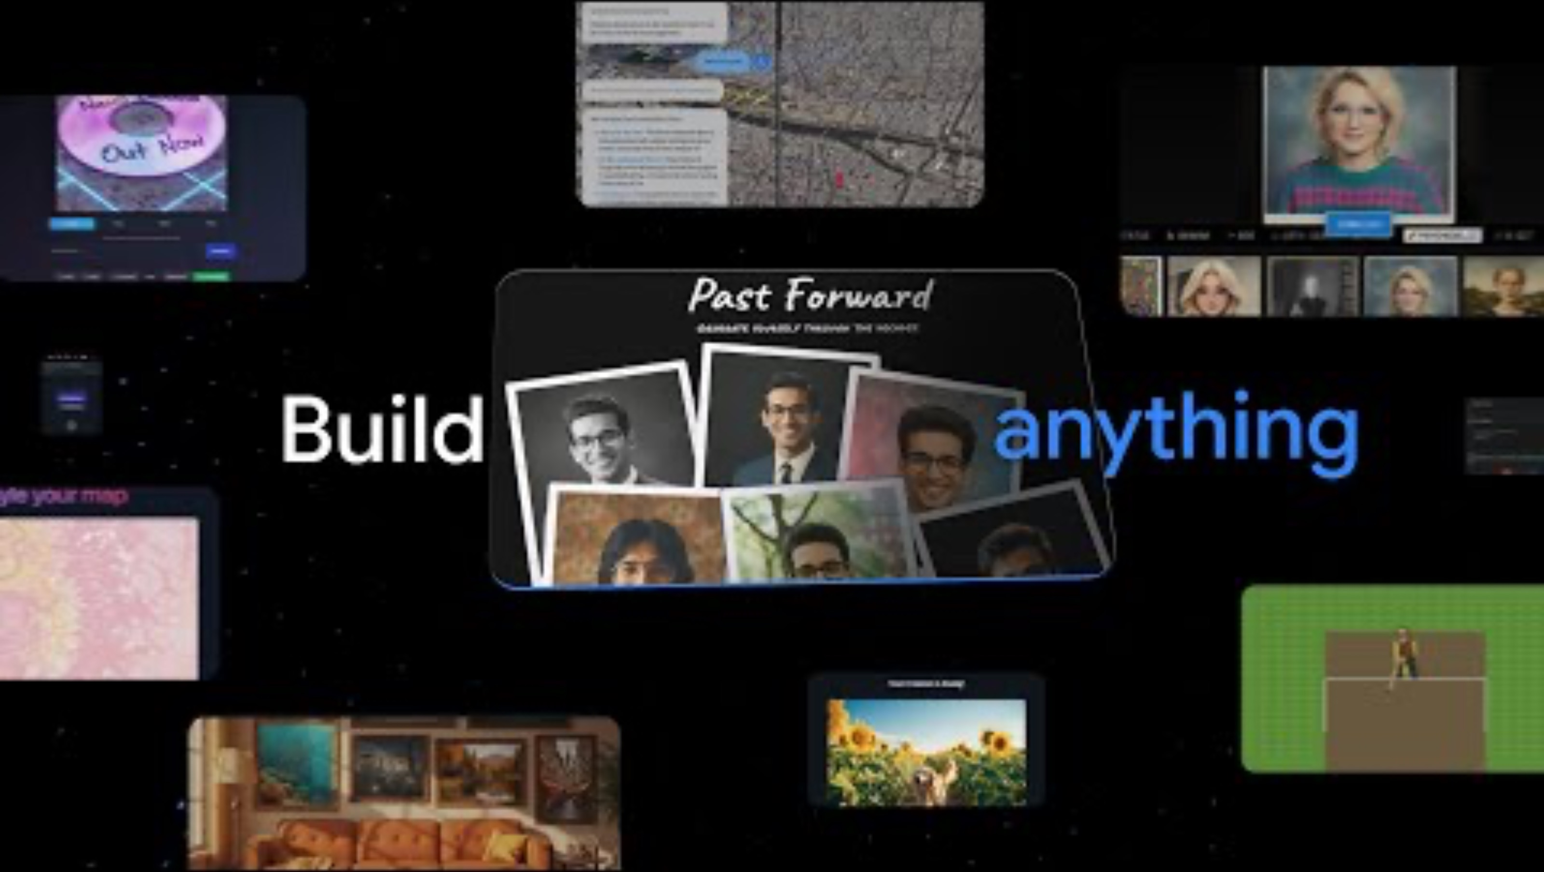
Vibe Coding with Gemini 3 in Google AI Studio

Slide 78
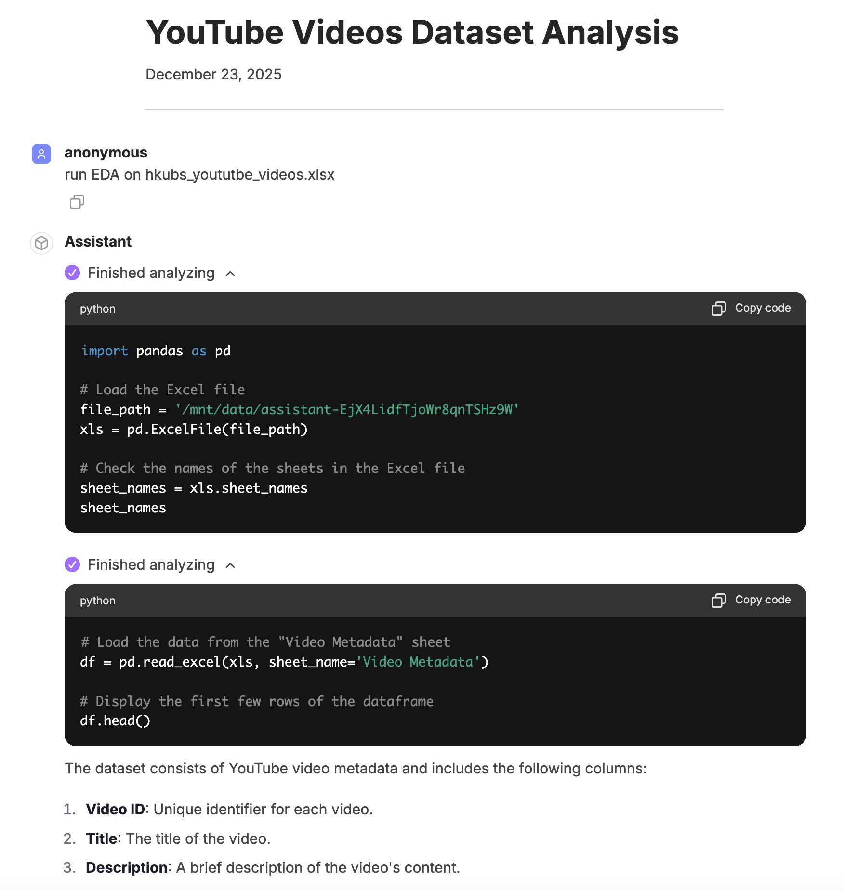
AI Data Analyst / Agent
https://code.hkubs.ai
Agent + Code Interpreter
Exploratory Data Analysis (EDA)
Machine Learning Modeling
Self Debugging
Chat History: https://code.hkubs.ai/share/KA-Pg_k3jDiUZwfLvJm1c

Slide 79
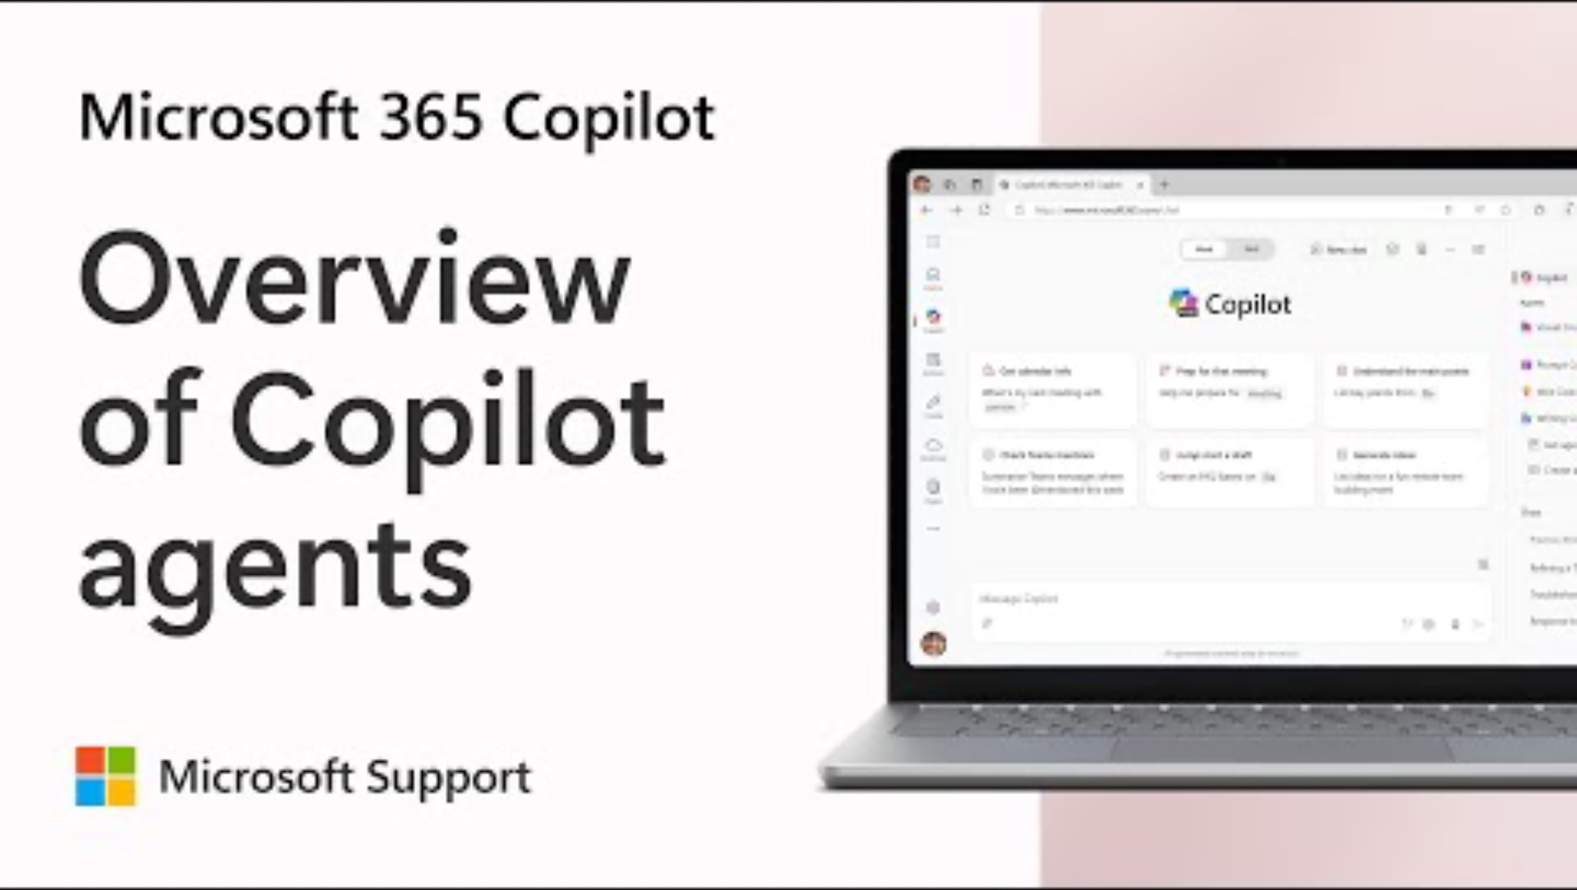
What are Microsoft 365 Copilot agents and how to use them

Slide 80

Shop with Perplexity: AI-Powered, Personal, Effortless

